Slide 1

Presenting the Clean Air Improvement Program:
Financial Tools for Project Development

Slide 2

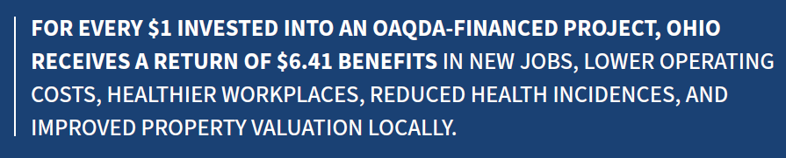
WHO WE ARE
Our mission is to improve air quality by supporting businesses, creating jobs, and improving communities while enhancing the health and safety of all Ohioans.
A resource for businesses of any size working to comply with environmental regulations or meet corporate sustainability goals
A non-regulatory, independent state agency, governed by a seven-member Board:
  Five members appointed by the Ohio Governor
  Two ex-officio members (Directors, EPA & Health)
For 50 years, OAQDA has been committed to serving the economic and environmental needs of Ohio businesses and communities.
Authorized by Chapter 3706 of the Ohio Revised Code.
            Christina O’Keeffe
            Ohio Air Quality Development Authority
            E-mail: info@aqda.state.oh.us
            Web: www.ohioairquality.org

Slide 3
CLEAN AIR IMPROVEMENT PROGRAM (CAIP)
Eligible uses and project type includes:
  Energy conservation measures (ECMs)
  Efficiently designed whole building (new or retrofit)
  Renewable energy (utility-scale or customer-sited)
  Clean transportation (electric, hydrogen, natural gas)
  Pollution control or recycling
All project requests are reviewed by OAQDA during a due diligence process to verify expected performance and then presented to the Board for approval. Strong focus on accountability and transparency.
            Christina O’Keeffe
            Ohio Air Quality Development Authority
            E-mail: info@aqda.state.oh.us
            Web: www.ohioairquality.org

Slide 4
CAIP FINANCIAL TOOLS
Ability to issue taxable or federally tax-exempt revenue bonds as a project financing tool for businesses of all sizes.
Credit enhancement:
  Loan Loss Reserve (LLR)
  Commercial Property Assessed Clean Energy (C-PACE)

Slide 5
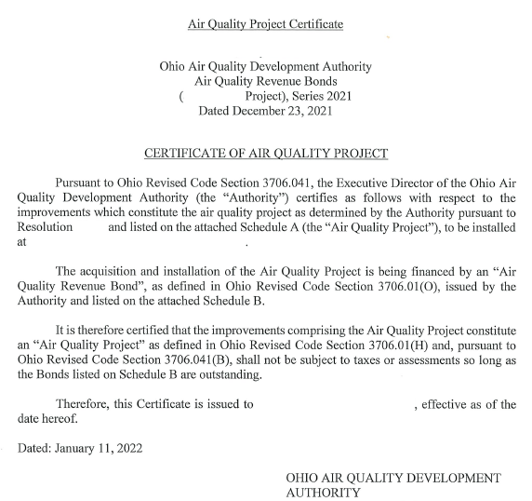
CLEAN AIR IMPROVEMENT PROGRAM (CAIP)
AIR QUALITY CERTIFICATE
Issued by OAQDA after closing
Exempts the approved air quality facility from applicable taxes (sales & use, real property)
Sent to project owner (borrower), local county auditor, and Ohio Tax Commissioner
Effective until bond maturity (which is aligned with asset’s useful life)

Slide 6
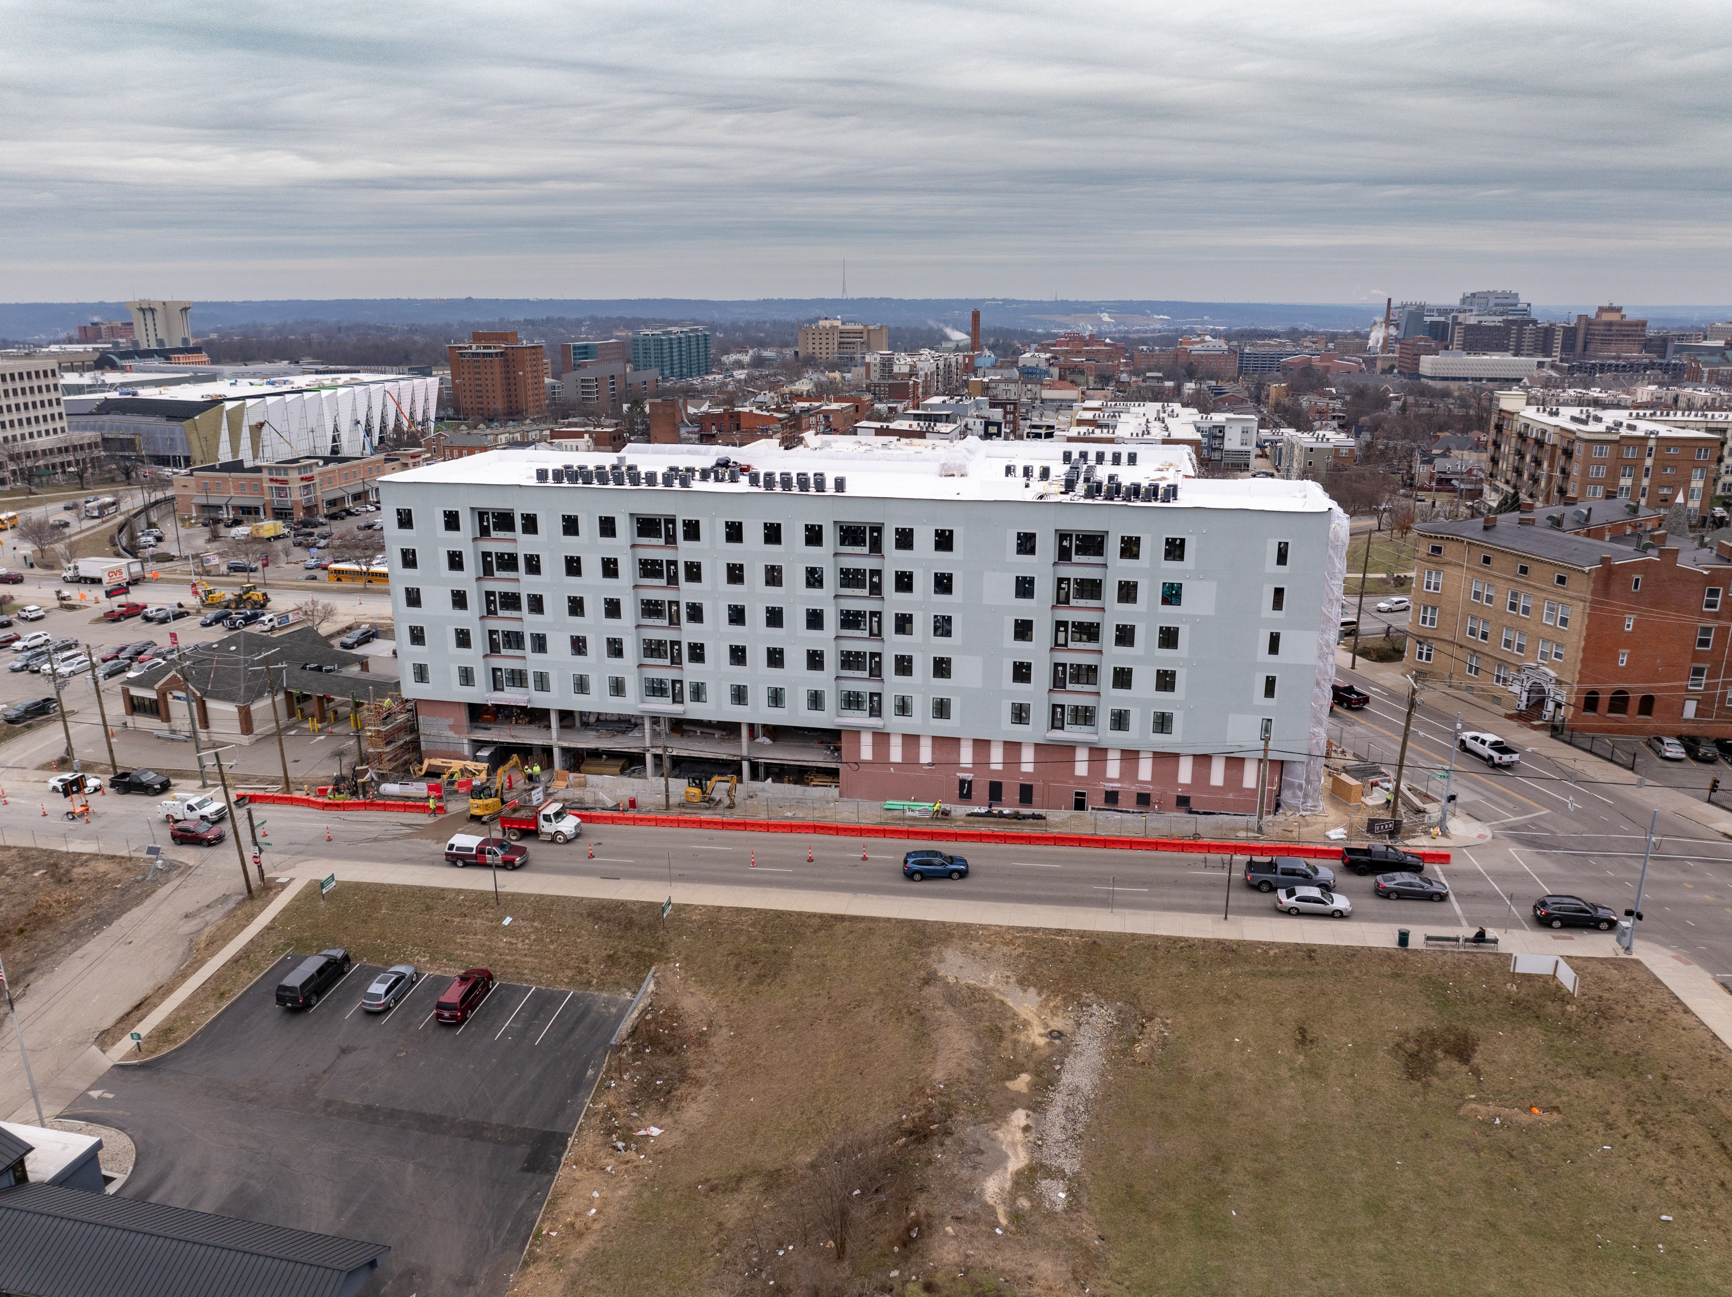
Case Study: 47 WHT, LLC (Cincinnati)
Efficiently-designed multifamily housing project
Provides student-focused housing
Utilized $22,800,000 in conduit bond issuance
Project improvements included:
  Rooftop solar
  Efficient HVAC
  Building envelope improvements
  ENERGY STAR appliances
Creates 200 full-time construction jobs

Slide 7
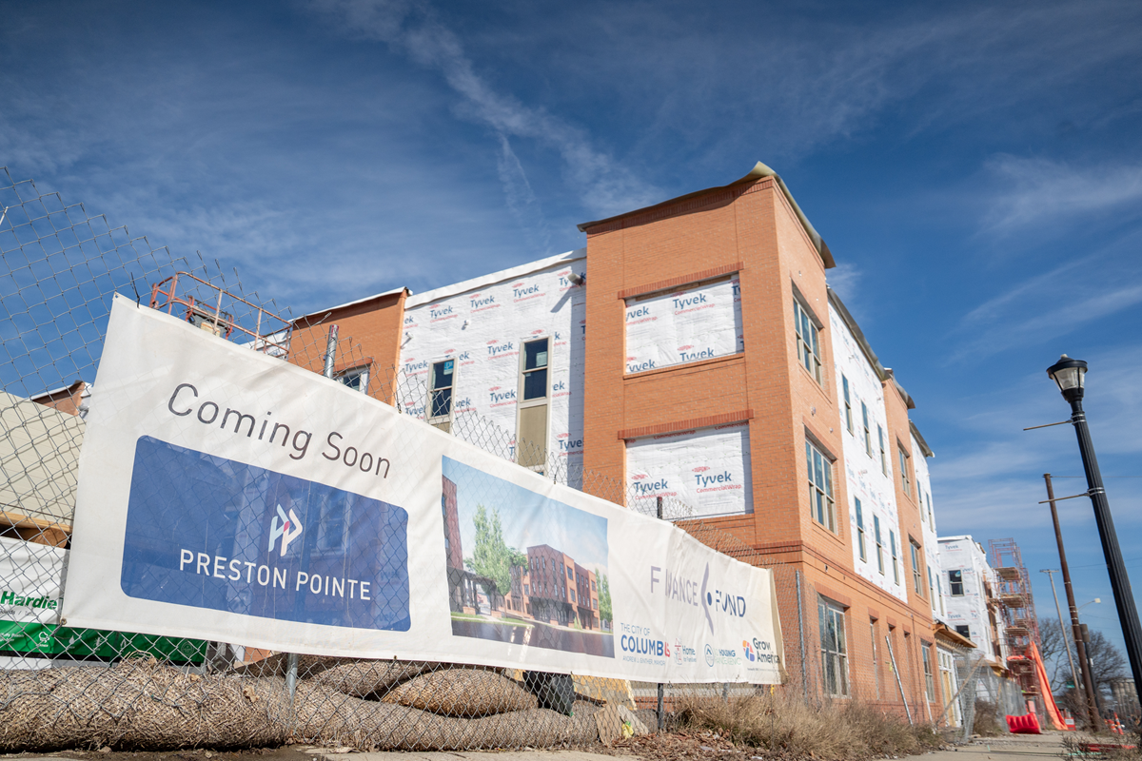
Case Study: Preston Pointe (Columbus)
Energy improvements on multi-family housing project
Affordable housing development
Utilized $14.25M in conduit bond issuance
Project improvements included:
  Rooftop solar
  Efficient HVAC
  Building envelope improvements
  ENERGY STAR appliances
  Central water heating
Achieved combined energy savings of over 60 percent

Slide 8
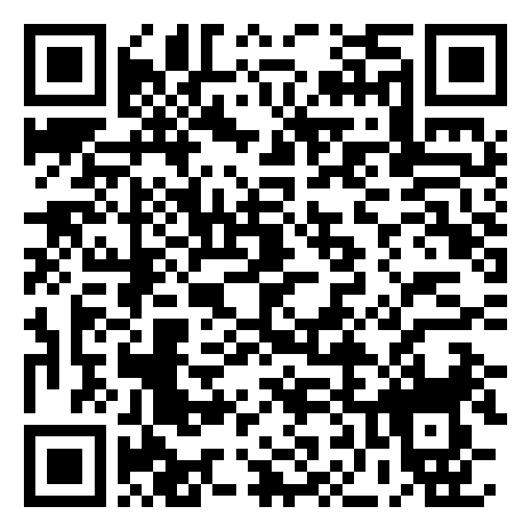
Questions?
Join our mailing list:
Brooke Grant
Programs Manager
E-Mail: Brooke.Grant@aqda.ohio.gov
Web: www.ohioairquality.ohio.gov
            Christina O’Keeffe
            Ohio Air Quality Development Authority
            E-mail: info@aqda.state.oh.us
            Web: www.ohioairquality.org

