Slide 1

OHC Spring Symposium Performance trends
April 22, 2026

Slide 2
Special Analysis Update
2021 thru 2025
Studied audited financials of set pool of properties actively reporting between 2021 and 2025
Methodology allowed for ‘same store’ comparison within the 5-year period
Data pool included 462 properties representing 27,759 Units across 6 states
Study encompasses 87 unique managing agents
Portfolio Trends & Update

Slide 3
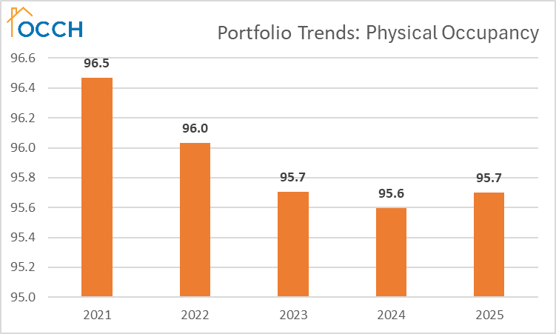
Physical Occupancy Trends
All 462 Properties
Portfolio-wide occupancy was nearly at all time high in 2019/2020
Steady decline to 14 year low in 2024
60% of properties occupancy decreased over five-year period
Portfolio Trends & Update

Slide 4
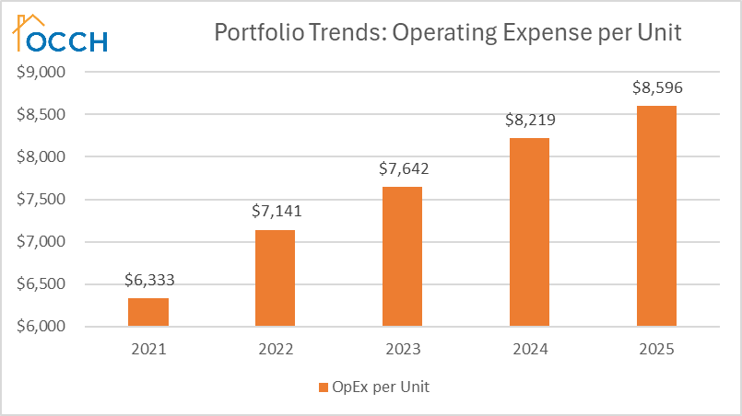
PUPA OpEx Trends
All 462 Properties
2025 OpEx increased 35.7% from 2021 (proforma expectation was 12.6%)
2025 PUPA OpEx was $8,596
2021 PUPA OpEx was $6,333
Portfolio Trends & Update

Slide 5
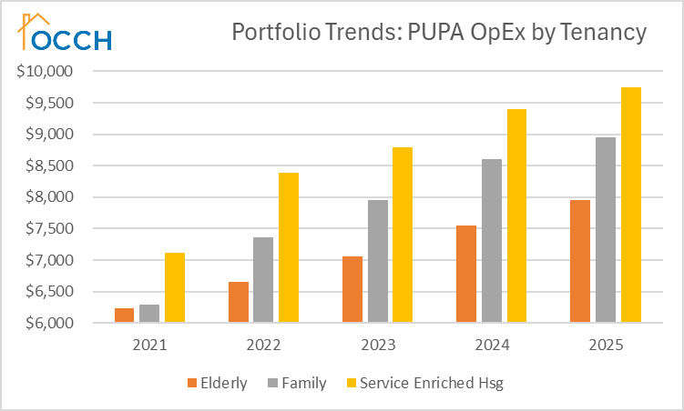
PUPA OpEx by Tenancy
All 462 Properties
Elderly continues to have lowest OpEx
  Less turnover
  Fewer occupants
Service Enriched Housing remains most expensive
  Property pd utilities
  Cost of Supportive Services sometimes included
Portfolio Trends & Update

Slide 6
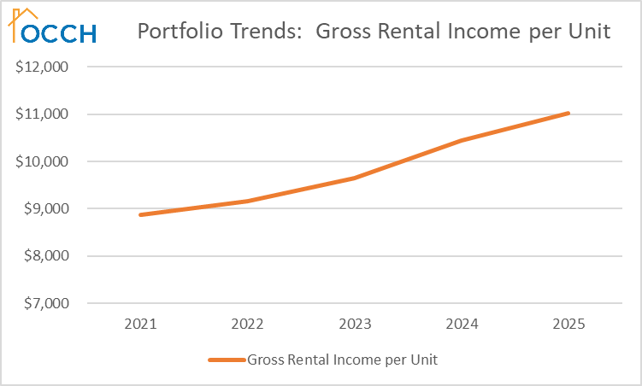
Growth in Gross Rental Income
All 462 Properties
Rent growth increased dramatically beginning in 2023
Average annual increase – 4.8%
Portfolio Trends & Update

Slide 7
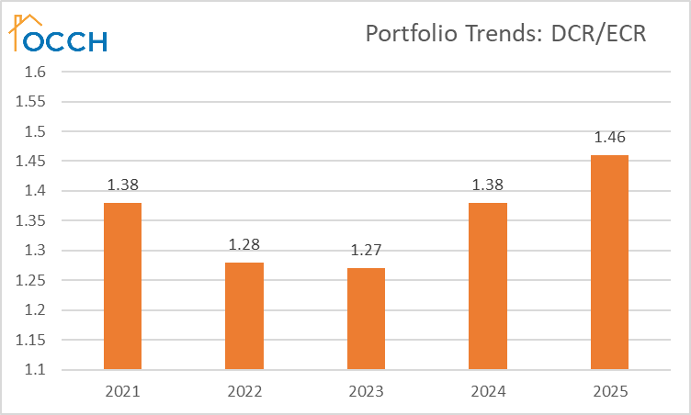
DCR Trends
All 462 Properties
Portfolio Trends & Update

Slide 8
Summary of Findings
All 462 Properties
OpEx continues to outpace rent growth
Insurance premiums continuing to substantially increase
Tenant receivables remain high in despite increase in Bad Debt expense
Portfolio Trends & Update

Slide 9
Key Takeaways
Summary Analysis
Staffing continues to be leading issue relating to property performance
  Property
  Regulatory
Rent growth still lagging OpEx growth
Bad Debt and Insurance continue to be the largest drag on OpEx
A large gulf remains between OCAF and Budget based properties
Portfolio Trends & Update

