Slide 1


We Open the Doors to an Affordable Place to Call Home

Slide 2



OHC Fall Symposium
OHIO HOUSING FINANCE AGENCY
UPDATE
September 2026

Slide 3
MULTIFAMILY PROGRAMS
Program Name
Credit Type
Construction Type
New Construction, Adaptive Reuse, and Rehabilitation
New Construction, Adaptive Reuse, Rehab
Funding Round
Additional Resources
9% LIHTC
9% LIHTC
Annual Round – Competitive
HOME (limited soft funds for CHDO)
4% LIHTC Only
4% LIHTC
Open Round
None
4% LIHTC – Affordable Assisted Living (AAL)
4% LIHTC
New Construction Only
Open Round
Medicaid Waiver
4% LIHTC + Bond Gap Financing (BGF)
4% LIHTC
Rehabilitation Only
Annual Round – Competitive
HOME, NHTF (limited soft funds)
4% LIHTC + Ohio LIHTC
4% LIHTC + Ohio LIHTC
New Construction, Adaptive Reuse
Annual Round – Competitive
Ohio LIHTC, OHTF (rural only)
New Construction, Adaptive Reuse, and Rehabilitation
4-24 units
Housing Development Gap Financing (HDGF)
N/A
Annual Round – Competitive
HOME, NHTF, OHTF, and/or R-TCAP

Slide 4
OFFICE OF MULTIFAMILY GUIDELINES
All OHFA Multifamily Programs
Design and Architectural Standards (DAS)
Multifamily Rental Underwriting
Experience and
Capacity Standards
Guidelines
4

Slide 5
OFFICE OF MULTIFAMILY GUIDELINES
9% LIHTC Program
9% LIHTC Qualified Allocation Plan (QAP)
5

Slide 6
OFFICE OF MULTIFAMILY GUIDELINES
4% LIHTC Program
4% LIHTC Qualified Allocation Plan
Multifamily Bond Guidelines
Affordable Assisted
Living (AAL)
( QAP)
4% LIHTC with Bond Gap Financing (HOME & NHTF)
6

Slide 7
OFFICE OF MULTIFAMILY GUIDELINES
9% and 4% Supplemental Programs
Housing
Multifamily Lending Program (MLP) Guidelines
CHDO Guidelines
Development Loan (HDL) Guidelines
7

Slide 8
OFFICE OF MULTIFAMILY GUIDELINES
HDGF Guidelines
Non-LIHTC for 4-24 Units
8

Slide 9

FUNDING SOURCES
GOAL: Most effective use of all the funding sources and
Reduce the number of guidelines.
9% LIHTC
4% LIHTC
HOME
NHTF
OHTF
9

Slide 10
GUIDELINE UPDATE TIMELINE
December 2026
June 2027
September 2027
Ohio Housing Conference Session kicks off stakeholder feedback
First Draft of QAPs & Guidelines (30 days comment period required for QAPs)
OHFA Board for Final Draft Approval
March 2027
Mid-July 2027
January 2028
Stakeholder Sessions: Columbus + Each Region
Second Draft
Effective Date
10

Slide 11


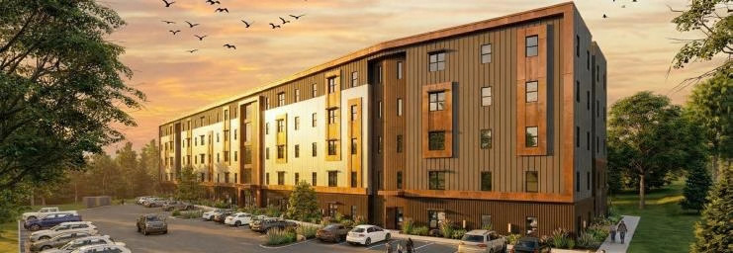

2828 May Street II, Cincinnati 2026 9%, SOCAYR
2026 9% LIHTC Additional Credit Policy

Slide 12
OVERVIEW
•
Purpose: Provide additional resources to projects that are experiencing:
documented construction cost increases within the original scope of work, reduced equity pricing, or other challenges that are affecting project feasibility
or the timely completion of affordable housing units to low-income Ohioans
•Available Resources: Eligible projects may request:
Up to $110,000inannual9% LIHTC(Approx:$1.45Mavailable)
Up to $1M in additional HDL resources
12

Slide 13
AVAILABLE RESOURCES
Additional Credits
•
Eligible projects may request up to $1M
Requested
$450,000
in HDL resources and the following amounts of 9% LIHTC per unit based on the project’s program year, capped at $110,000 per project:
Available
$1,000,000
2026-2027 9% LIHTC QAP: Ineligible 2024-2025 9% LIHTC QAP: Up to $1,500 per unit
2022-2023 QAP: Up to $3,000 per unit
Ava i la bl e
Reques ted
•Deadline to submit applications to
QAP@ohiohome.org :
•
October 1, 2026
13

Slide 14

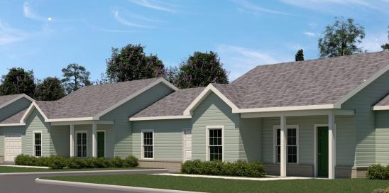


Fountain Creek Senior, Bryan
2025 9%, Frontier Community Services
2027 CHDO Guidelines and Application – First Draft

Slide 15
2027 CHDO GUIDELINES AND APPLICATION TIMELINE
First draft Sept 2026
9% LIHTC Proposal Applications due Feb 2027
Final draft
CHDO Applications
Oct 2026
due Jan 2027
•15-day comment
•Submission window:
period, due Sept 24
• QAP@ohiohome.org
Nov 30 to Jan 7
15

Slide 16

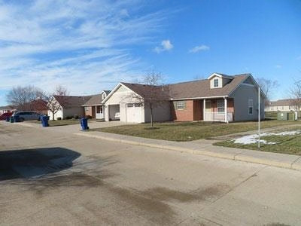



Arthur Place, Columbus
2024 4% BGF, Buckeye Community Hope Foundation
2026 4% LIHTC with Bond Gap Financing - Draft

Slide 17


BOND GAP FINANCING (BGF)
2026 Draft Two
September 10 –
2026 Draft One
Final Draft
August 13 –
October
August 27
September 24
Committee
17

Slide 18
2027 DAS
Focusing on Policy and Partnership

Slide 19
2027 DAS TIMELINE
Sept 17, 2026
Dec 1, 2026
Dec 15, 2026
OHFA Board Approval of the 2027 DAS
2027 DAS Effective for Applications
2027 Ohio LIHTC Final Applications Due
Nov 2026
Dec 2, 2026
Post updated Forms
Ohio Housing Conference Session
19

Slide 20
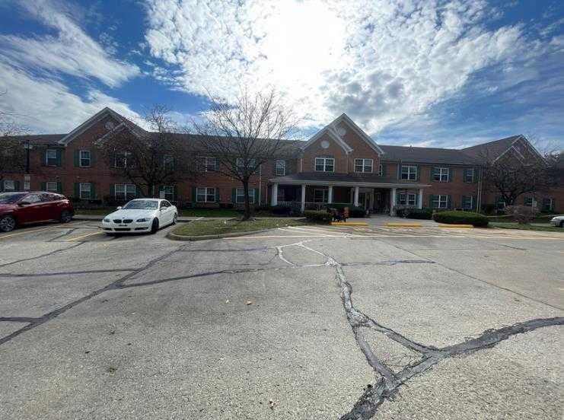


Seton Square South and West, Columbus
2025 4%, Seton Development & Borror Development Co.
Year 30 & Resyndication
20

Slide 21
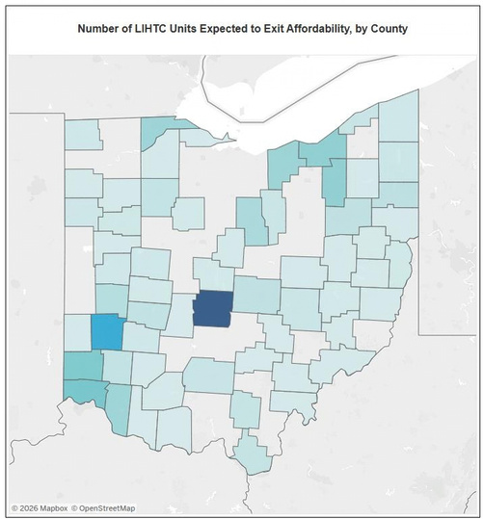
PROJECTS EXITING LIHTC PROGRAM AFFORDABILITY PERIOD
•OhioHome.org > Research & Analytics >
Program Dashboards
•Exiting Affordability
21

Slide 22
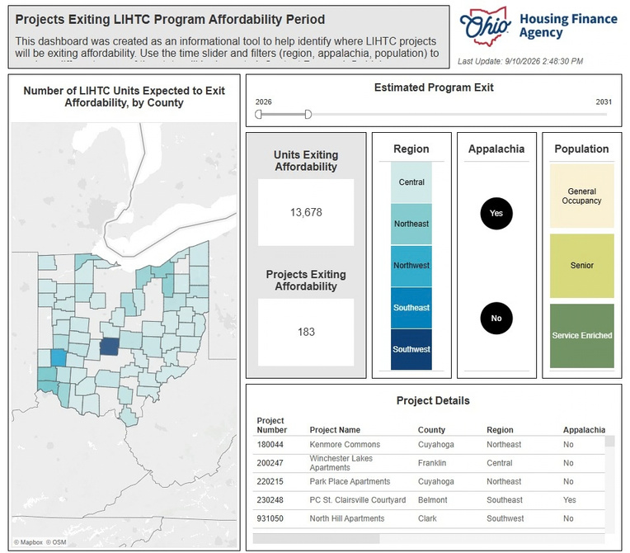
PROJECTS EXITING LIHTC PROGRAM AFFORDABILITY PERIOD
22

Slide 23
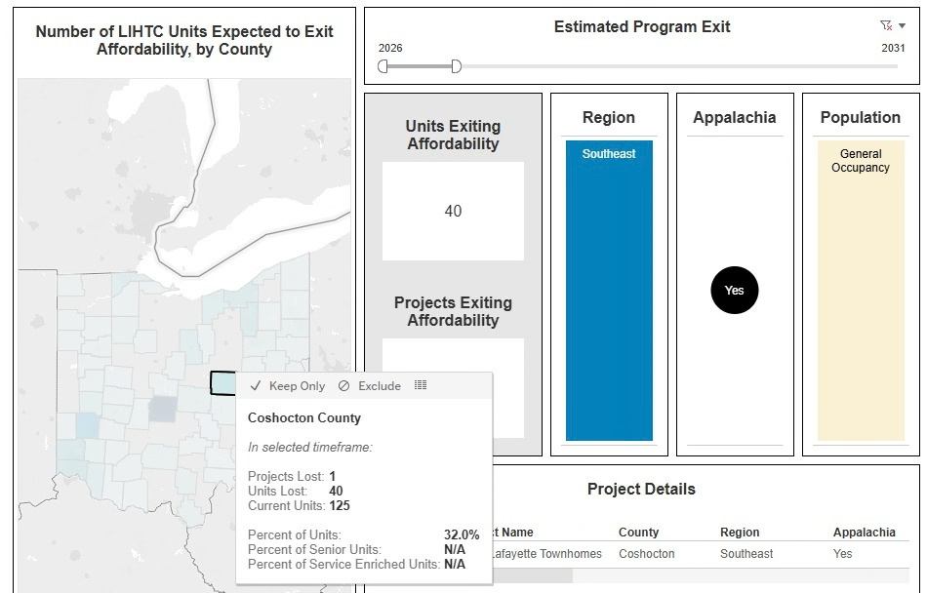
PROJECTS EXITING LIHTC PROGRAM AFFORDABILITY PERIOD
23

Slide 24
RESYNDICATION
• • • •
Bundling properties within proximity to achieve 4% LIHTC only application Multifamily Lending Program (MLP)
Housing Development Loan (HDL) Program
Prior HDAP Restrictions – Want to utilize new 2025 HOME Rule rents/incomes? (Requires modification)
Have a solution? Talk to OHFA staff
•
24

Slide 25





PRESENTER AND CONTACT INFO
Matt Sutter
Senior Director of Housing Programs
Barbara Richards
Director of
Multifamily Housing
Cody Price
Benjamin Peyton
Jennifer Cahill
9%HousingTaxCredit
4% Housing Tax Credit
Architecture & Construction
Section Chief
Section Chief
Section Chief
msutter@ohiohome.org
brichards@ohiohome.org
cprice@ohiohome.org
bpeyton@ohiohome.org
jcahill@ohiohome .org

Slide 27
Working with OHFA
Jennifer Cahill, Architecture & Construction Section Chief
jcahill@ohiohome.org
(614) 387-1646
www.ohiohome.org
You can also send feedback to: DAS@ohiohome.org

