Slide 1


Who We Are
POAH is a nonprofit organization whose mission is to preserve, create, and sustain affordable, healthy homes that support economic security and access to opportunity for all.

Slide 2
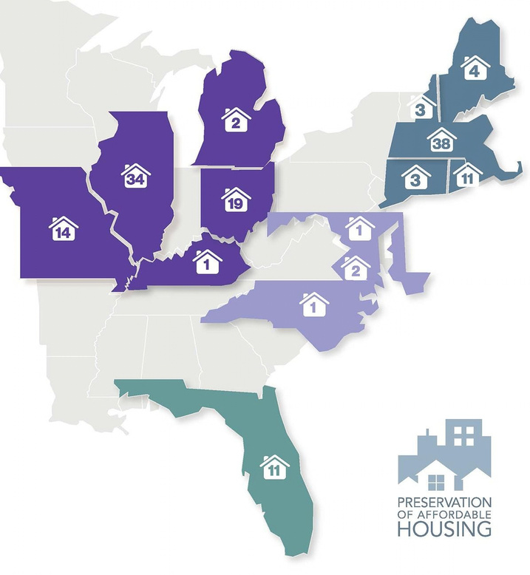
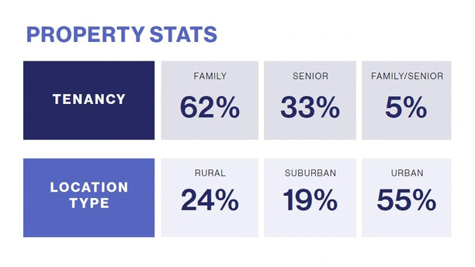
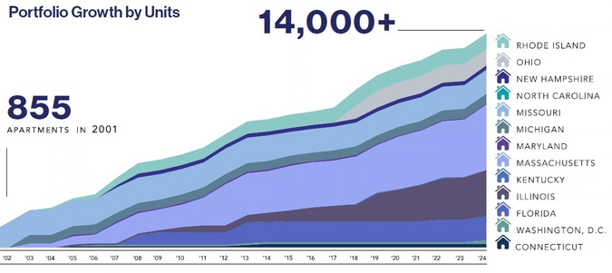
Where we are located

Slide 3
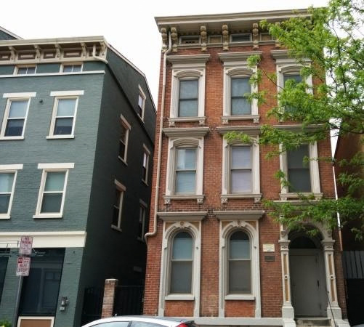
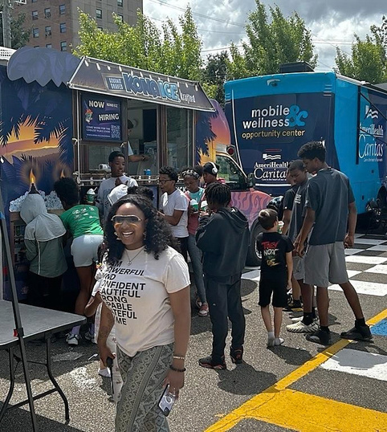
POAH in Ohio
19
owned
properties
280 buildings
1094
residential
units
2400 residents

Slide 4
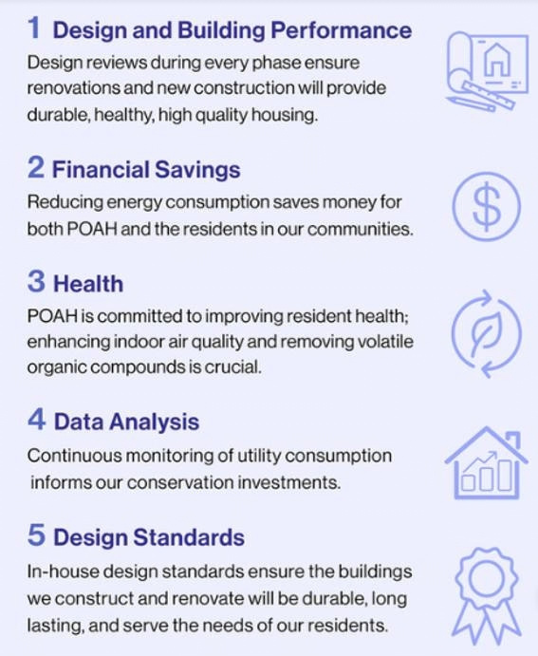
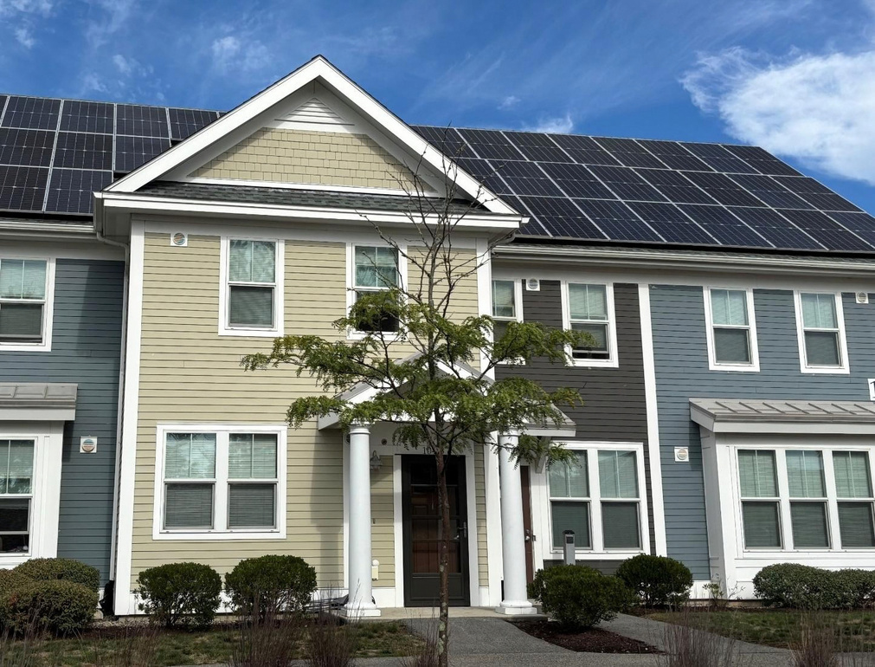
Mission for Sustainability

Slide 5
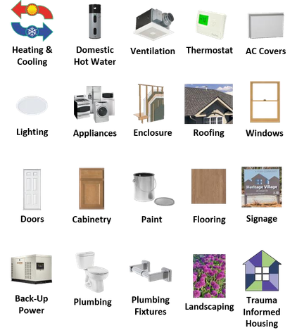




The Basis of Design
An open-source design guideline that specifies products used for constructing and operating our properties
INCREASE CONSISTENCY ACROSS ALL PROPERTIES
Standardize purchasing and maintenance
CREATE A FEEDBACK LOOP
Learnfrommistakesandmakebetter
decisions
DEVELOP POAH/POAHC’S BRAND
Create an image of quality, affordable housing
UTILIZE HPN SELECT VENDORS
Takeadvantageofportfolio-widesavings

Slide 6
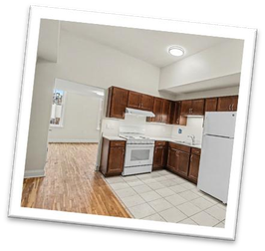
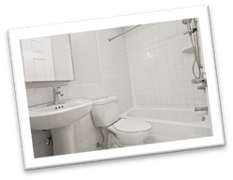
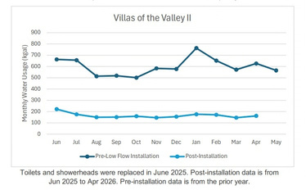
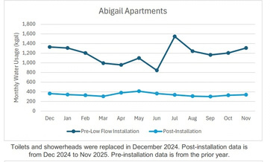
The Need for a Basis of Design
Operational Costs
(Resources & Money)
Performance
10𝑚𝑖𝑛 365 𝑑𝑎𝑦𝑠 10 𝑦𝑒𝑎𝑟𝑠 2.5𝑔𝑎𝑙 𝟗𝟏.𝟐𝟓𝒌𝑮𝒂𝒍
𝑑𝑎𝑦
∗
∗
∗
=
Standards
𝑦𝑒𝑎𝑟 𝑠ℎ𝑜𝑤𝑒𝑟ℎ𝑒𝑎𝑑 𝑚𝑖𝑛 𝒔𝒉𝒐𝒘𝒆𝒓𝒉𝒆𝒂𝒅
2.5 GPM (Gallons Per
1.5 GPM (Gallons Per
91.25 𝑘𝐺𝑎𝑙
∗
$11
=
$𝟏,𝟎𝟎𝟒
Minute)
Minute)
𝑠ℎ𝑜𝑤𝑒𝑟ℎ𝑒𝑎𝑑 𝑘𝐺𝑎𝑙 𝒔𝒉𝒐𝒘𝒆𝒓𝒉𝒆𝒂𝒅
Sets the efficiency standard for our products
10 𝑚𝑖𝑛
∗
365 𝑑𝑎𝑦𝑠
∗
10 𝑦𝑒𝑎𝑟𝑠
∗
1.5 𝑔𝑎𝑙
=
𝟓𝟒.𝟕𝟓 𝒌𝑮𝒂𝒍
𝑑𝑎𝑦
𝑦𝑒𝑎𝑟 𝑠ℎ𝑜𝑤𝑒𝑟ℎ𝑒𝑎𝑑 𝑚𝑖𝑛 𝒔𝒉𝒐𝒘𝒆𝒓𝒉𝒆𝒂𝒅
54.75 𝑘𝐺𝑎𝑙
∗
$11
=
$𝟔𝟎𝟐
𝑠ℎ𝑜𝑤𝑒𝑟ℎ𝑒𝑎𝑟𝑑 𝑘𝐺𝑎𝑙 𝒔𝒉𝒐𝒘𝒆𝒓𝒉𝒆𝒂𝒅

Slide 7
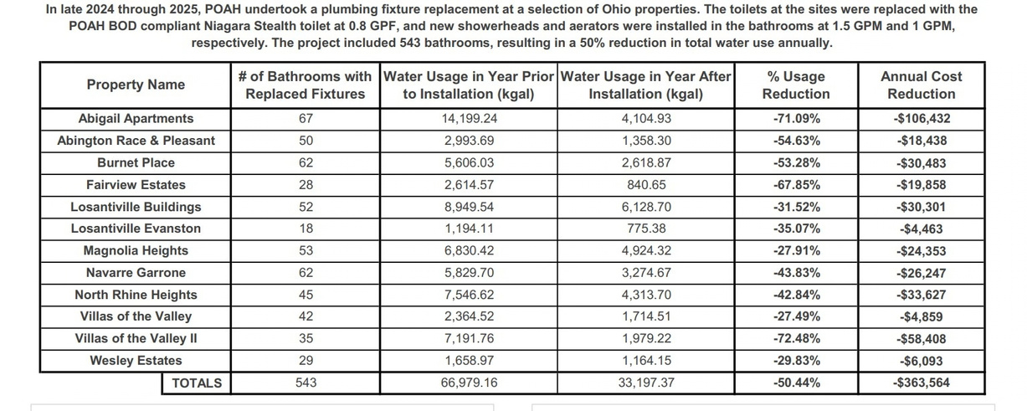
Ohio Low Flow Water Projects

Slide 8
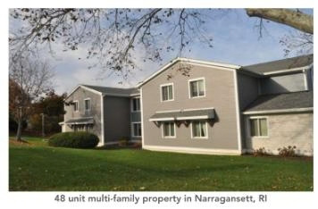
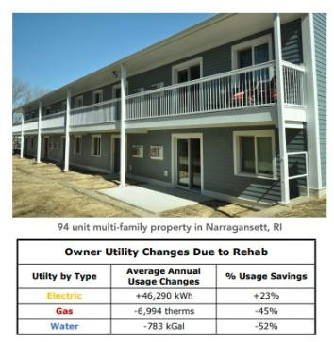
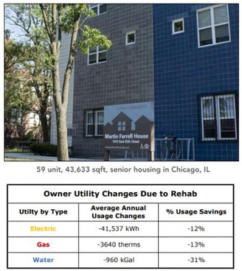
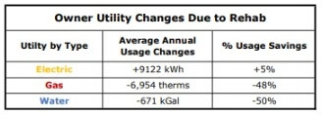


Post Rehab Highlights
Summaries of key outcomes and benefits from recent rehabs and discreet energy & water saving
projects. The Highlights are produced 9 to12 months after completion and evaluate the current
utility use and carbon emissions to historical data.

Slide 9
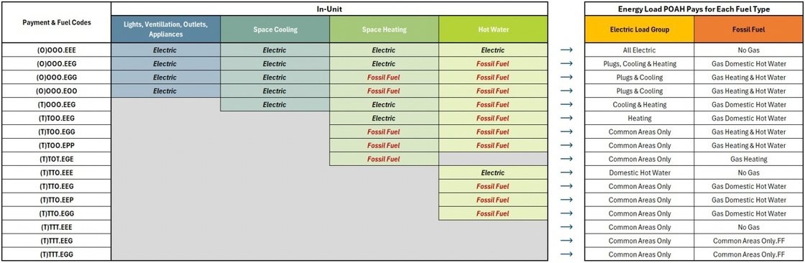
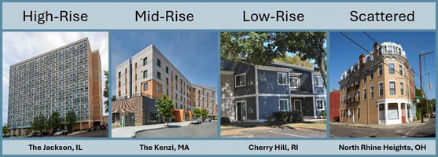
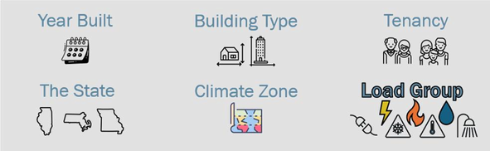
Setting priorities
POAH does not pay for all the utilities at a given property. We cannot compare any
Property to another. To understand a property's utility usage, we need to know the utility being used and what it's being used for.

Slide 10
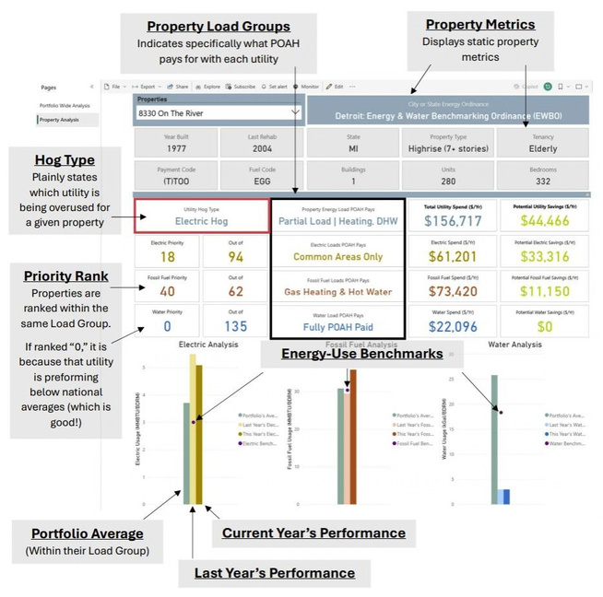
Utility Dashboard
The Utility Use Dashboard allows us to reliably analyze and compare a property’s energy usage to itself/prior years, the portfolio, and the nation. We do this with:
•
Weather Normalization: Adjusts energy consumption to account for variations in weather, allowing for a year-to-year comparison for a property
Load Groups: Identifies the specific utility end-uses POAH pays for, allowing a Property-to-Property comparison, &
Utility-Use Benchmarks: Factors in physical characteristics & load groups
of the property, allowing a Property-to- National Average comparison
•
•

Slide 11
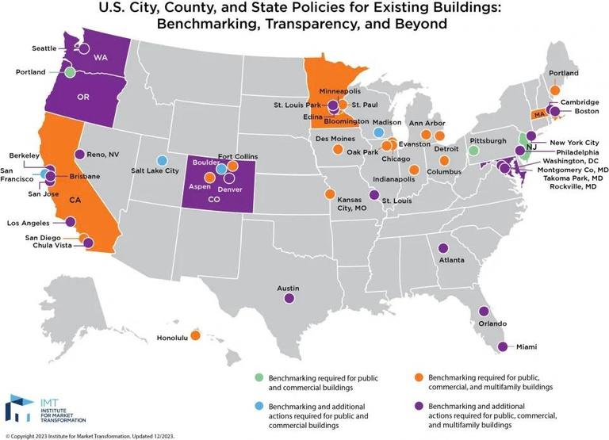

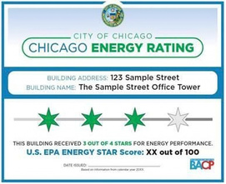
Benchmarking
POAH currently reports energy use for nine (9) other city and state ordinances. Only the Boston
Ordinance is the only one so far to set fines for exceeding emissions limits, others still issue fines for failing to report, and more cities are expected to begin setting limits on emissions as more data is collected.

Slide 12

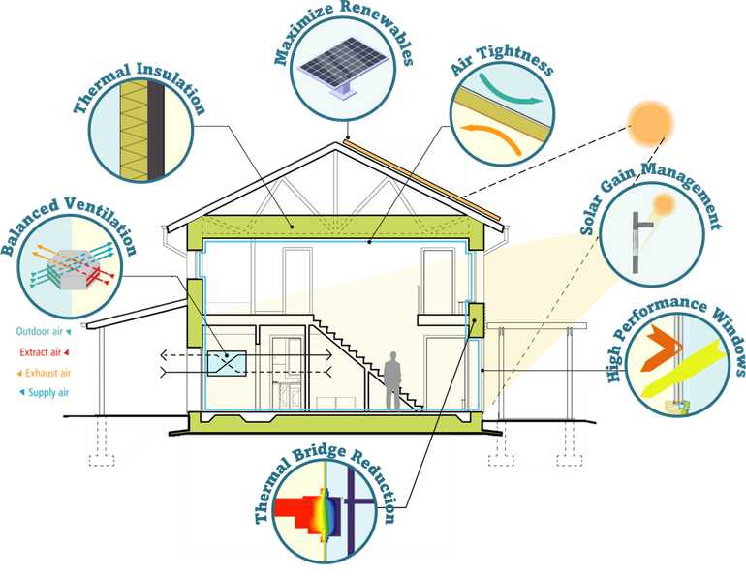
Why PHIUS?
Phius focuses on:
Cost Optimization Between Savings
and Implementation
Guaranteed Indoor Air Quality &
Long-Term Resiliency
Climate Specific Design Goals
Accountability through Stringent
Review & Verification Process
Future Proof – Anticipates and Exceeds Local Building Codes

Slide 13
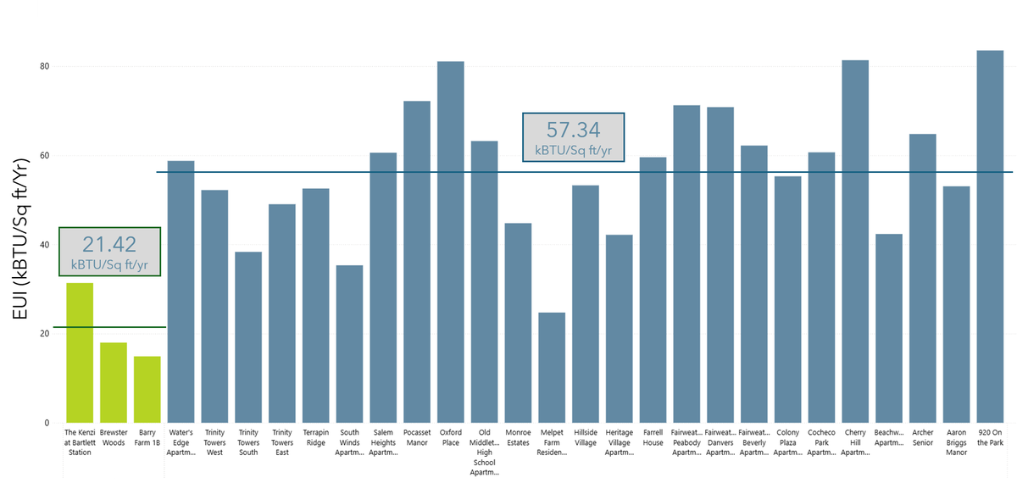
PHIUS Energy Use Intensity
Passive House buildings use 63% less energy per square foot than median new multifamily (LEED, Code)

Slide 14
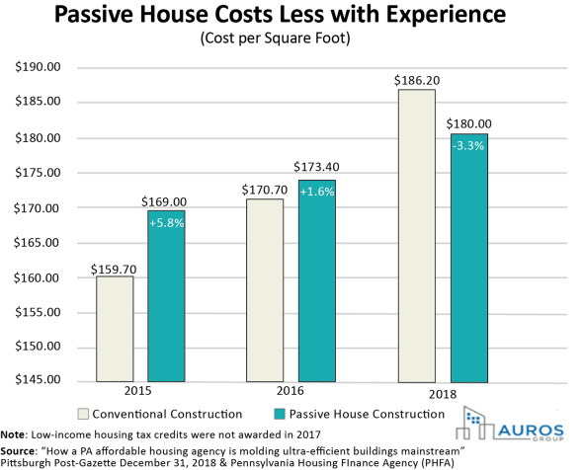
PHIUS Cost Relativity

Slide 15

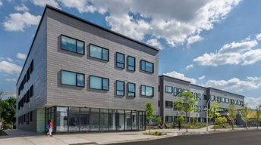
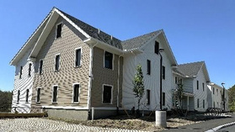
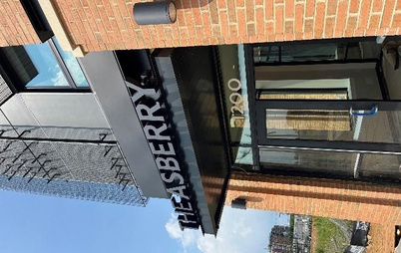

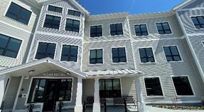
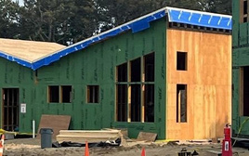
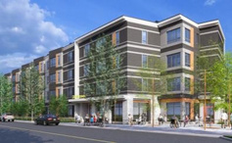
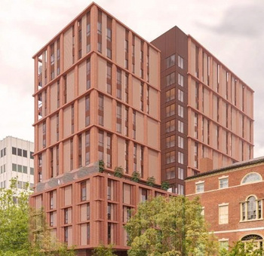
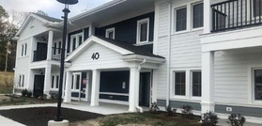
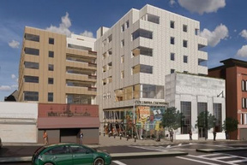
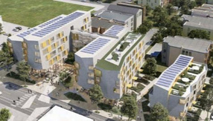
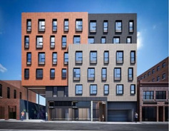
PHIUS Pursuits
Certified
Certified
Certified
Certified
Certified
Certified
Design Certified
Design Certified
Design
Registeredand
Certified
In Planning
Design Certified
In Planning
Certified

Slide 16

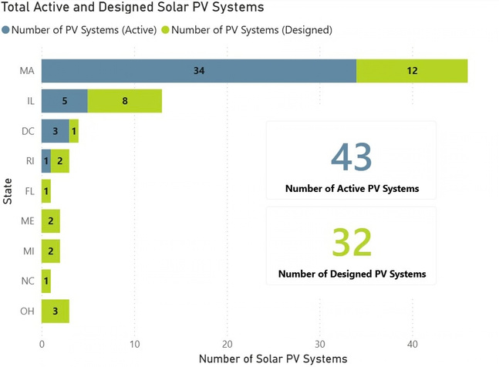
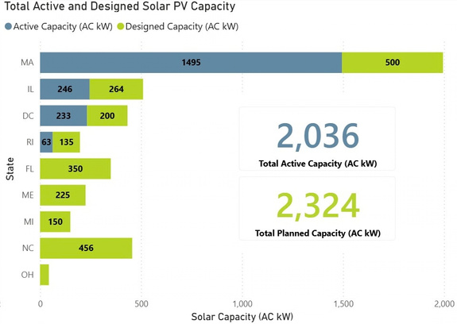
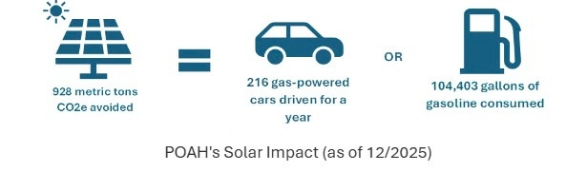
POAH Renewables

Slide 17
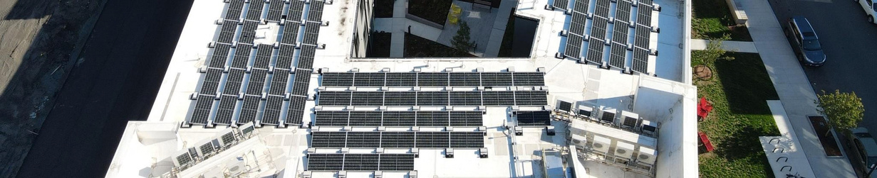
Renewables ROI
Property
ROI without Incentives
7.9
7.6
10.1
6.5
7.6
5.5
10.6
11.3
10.5
8.6
ROI with Incentives
(ITCs & RECs) 5.1
4.9
6.6
4.2
4.9
3.6
6.9
7.3
6.8
5.6
Asberry (Barry Farm 1B)
Brewster Woods
Cape View Way
Flat 9 at Whittier 2
Jesse Jackson Jr Senior Housing
LeClair Village
Melpet Farm Residences
Oxford Place
Terrapin Ridge
AVG

Slide 18
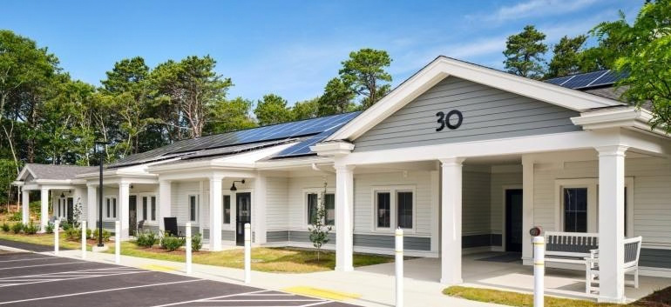
Thank you!

