Slide 1
Changes to the Federal Response to Homelessness
Erica Mulryan, Ohio BoSCoC Director, COHHIO
April 22, 2026

Slide 2
Continuum of Care Overview
CoC Program = Largest federal response to homelessness
CoC = The homeless response system covering a particular geographic area
CoC = The decision-making body of the homeless response system
Notes:
The term ‘CoC’ has a couple sightly different meanings within the homeless services sector. The term is often used to refer to the…. And decision-making body… and also is the name of the program that represents the largest federal response to homelessness.
For my purposes today, I’ll primarily use the term to refer to the homeless response system operating with a particular geo area, and to refer to the federal program.

Slide 3
Continuum of Care Overview
CoC Responsibilities
Coordinating and implementing the response system
Managing program and system performance
Operating a ‘Coordinated Entry’ system
Standardizing provision of assistance
Conducting annual counts of homelessness and gaps analyses
Operating a Homeless Management Information System
Submitting application for federal grant funding
Notes:
In order to access key federal funds to address homelessness, CoCs must ensure they fulfill these responsibilities, at minimum.

Slide 4
Continuum of Care Overview
CoC Responsibilities – How?
Designate entity to serve as CoC Lead (i.e. ‘backbone agency’) to lead system coordination and planning work and ensure fulfillment of CoC responsibilities
CoC Board, Committees/Workgroups, work with CoC Lead
Elevate voices of those with lived experience

Slide 5
Continuum of Care Overview
CoC Operations – Shared Responsibilities
CoC Lead
  Leads overall system planning & coordination, ensures fulfillment of CoC responsibilities, has dedicated staff
CoC Board, Committees/Workgroups, work with CoC Lead
  Adhere to CoC Governance Charter
  Groups include providers, PLE, CoC staff, local government officials, other stakeholders
Local Government
  Coordinate with CoC Lead and CoC Bodies on CoC responsibilities and larger goals
  Allocate federal & local funds for homeless services
Homeless Services Providers
  Operate programs
  Receive grant funds
  Strive to achieve program performance goals

Slide 6
Continuum of Care Overview
Ohio CoCs
Akron/Barberton/Summit County CoC
Canton/Stark County CoC
Cleveland/Cuyahoga County CoC
Columbus/Franklin County CoC
Cincinnati/Hamilton County CoC
Dayton/Montgomery County CoC
Toledo/Lucas County CoC
Youngstown/Mahoning County CoC
Ohio Balance of State CoC

Slide 7
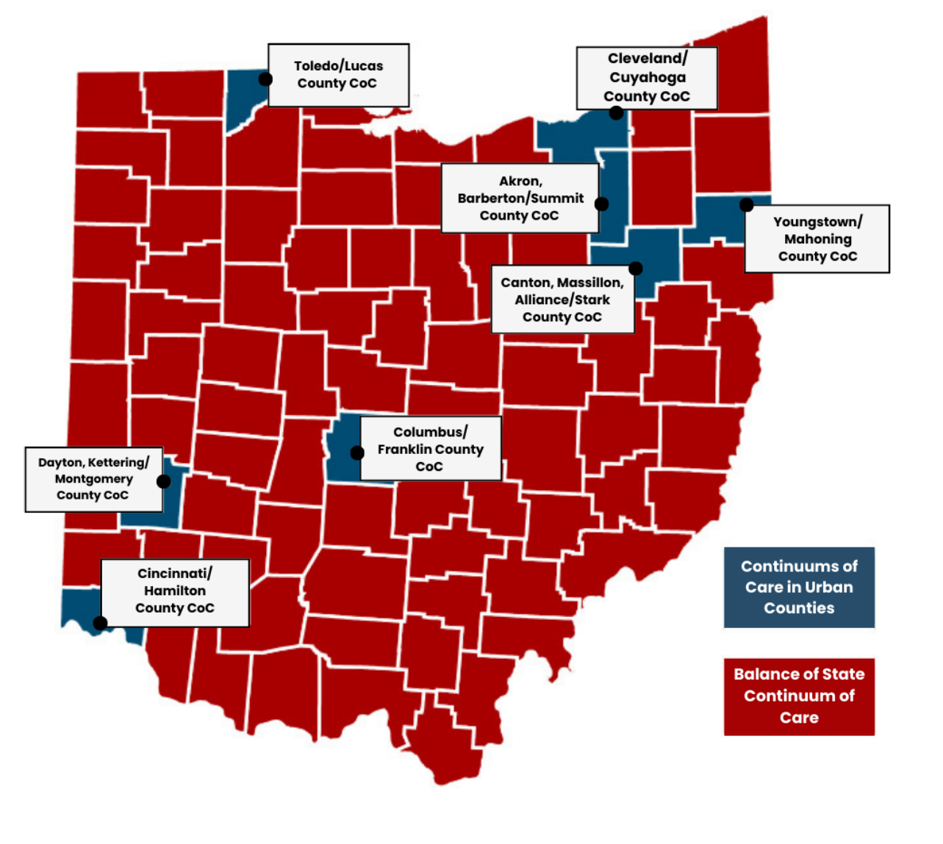
Continuum of Care Overview
Ohio CoCs

Slide 8
Continuum of Care Program
McKinney-Vento Homeless Assistance Act
  Signed into law in late 1980s
  First large federal response to homelessness
  Created Supportive Housing Program, Shelter Plus Care Program, Emergency Shelter Grant program
HEARTH Act
  Signed into law in 2009
  Reauthorized and amended McKinney-Vento
  Created Continuum of Care Program and Emergency Solutions Grant Program
Notes:
Which leads me to my next slides, where you’ll see some information about the history of the federal response to homelessness and the CoC program in particular.
The first large federal response to homelessness came about with the passage of the…

Slide 9
Continuum of Care Program
Historical Policy Priorities
  Stability in homeless response systems
  Permanent housing over time-limited assistance
  Use of evidence-based practices, like Housing First
  Awarding funding based on system improvements and outcomes
    Increased exits to housing
    Increased receipt of benefits and income
    Reduced returns to housing
    Prioritization of assistance for those with more homelessness history
Notes:
Hud began implementing these policy priorities in early/mid 2000s and then with the passage of the HEARTH Act in 2009, they were further cemented into the fabric of the program and woven throughout the competitive application process. HUD implemented these priorities by incorporating them into the scoring process for competitive CoC Program awards decision making and into selection criteria for new project applications. HUD helped create more stability in homeless response systems by investing funding in renewal projects, while also maintaining a competitive application process where the most intense competition was focused on funding for new projects

Slide 10
Continuum of Care Program
Funding
  Provides about $4 billion in grant funding annually​
  Nearly $180 million in funding to grants in Ohio CoCs​
  90% of grants are for Permanent Housing (PH) projects​, including PSH
  Typically, 90%-100% of CoC funding supports renewal projects
Notes:
CoC Program provides $4 billion annually to communities and providers
In contrast, federal ESG program annually allocates about $290,000,000 (7% of CoC funding level)
In Ohio, $13 million to all ESG juridisctions and of that, about $6 million goes to the state for distribution

Slide 11
Continuum of Care Program
Eligible Project Types
  Transitional Housing
  Rapid Re-Housing*
  Permanent Supportive Housing*
  Infrastructure – HMIS, Coordinated Entry, Systems Planning
  *90% of CoC funding supports these project types
Notes:
In contrast, ESG funds shelter, outreach, limited HP and RRH

Slide 12
Continuum of Care Program
Eligible Activities
  Rental assistance of leasing assistance
  Supportive services
  Operations
  Admin
  Planning/HMIS
Notes:
Within each project type, CoC funds may generally be used to support these eligible activities

Slide 13
CoC Program
CoC Program – Typical Funding Process​
  Annually/semi-annually, HUD releases a Notice of Funding Opportunity (NOFO) and opens its competitive application process​
  Typically, 90%-100% of CoC funding supports renewal projects​
Notes:
And as I previously mentioned, HUD’s policy priorities – PH vs. TH, best practices, stability, awards based on system performance – are incorporated into the NOFO, funding availability, and scoring criteria

Slide 14
CoC Program
Changing Federal Priorities
  Trump administration released E.O. on homelessness July 2025 - 'Ending Crime and Disorder on America's Streets’’
  Key Provisions​
    Attack on Housing First and Other Evidence-Based Approaches​
    Forced Institutionalization via civil commitment​
    Rewarding communities that enact or enforce local laws that penalize public camping or squatting
Notes:
Now I’d like to talk about what has happened in the federal homelessness response space over the past 6 months or so. As you would imagine, the change in administration meant a change in policy priorities, including those priorities that guide the federal response to homelessness. One of the first previews of the federal policy shift came with the release of the E.O. on homelessness in July 2025.. That E.O. included attacks on HF and other evidence-based practices, outlined an interest in using forced institutionalization via civil commitment to remove unsheltered persons from the streets, and indicated an interest in rewarding communities that enact and enforce local laws to penalize public camping
HF – ending grant support for HF and harm reduction practices, prohibiting those practices in grant funded projects, requiring forced participation in services for assistance
Civil Commitment – directs HUD and others to figure out how to use civil commitment to force unsheltered homeless into institutions and off the streets
Criminalization – directed HUD and others to identify how they can award grants to communities advancing criminalization efforts and deny to communities without criminalization laws

Slide 15
CoC Program
Changes to FY2025 CoC NOFO
  Prioritized time-limited projects and street outreach
  Capped funding for PH projects to no more than 30% of current funding for CoCs
  Capped ‘safe renewals’ at 30% of total request
  Requires forced participation in services
  Communities engaged in criminalization may be more competitive
  Expanded ‘risk review’ of projects that allows HUD to deny awards based on information indicates potential grantee engaged in activities that contradict HUD policy priorities
Notes:
HUD, in turn, incorporated directives from the E.O. into its competitive funding process for the CoC Program which is, again, the largest federal response to homelessness and in many places (like the BoS) the primary funding source for the entire homeless response system.

Slide 16
CoC Program
Federal Court Case
  HUD sued by several states and national advocacy organizations
  HUD prevented from releasing FY2025 CoC NOFO
Congressional Action
  T-HUD Appropriations bill required HUD to renew FY2025 renewal funding
  Forces HUD to renew at least 60% of CoC funding in next competition
Notes:
In response to the FY2025 NOFO, several states and national advocacy groups sued HUD claiming - Non-compliance with statutory requirements for timing of NOFO release, Policy direction changes that contradict Congressional authorization, The proposed changes would cause irreparable harm

Slide 17
Federal Policy to Address Homelessness
Status of Federal Court Case
  Court ordered HUD to stop moving forward with the FY2025 NOFO and required HUD to take steps to process renewal grants
    HUD communicated basic process steps in early January 2026
    Although we hope renewals will be processed in Spring 2026, some grantees will have gaps in funding
  Final decision expected in March 2026
Notes:
Since the filing, there have been a few hearings in federal court. At the most recent hearing on 12/19, the Jude ordered…
Additonally, there is still uncertainty around funding – if plaintiffs don’t win the court case, HUD indicated they will not continue processing renewals and will re-issue the FY2025 NOFO they previewed in November. There is also some work happening in appropriations in Congress that could be helpful here, but only if it passes. IF the plaintiffs win the court case, HUD has telegraphed its intent to appeal.

Slide 18
Preparing for New Federal Priorities in CoC Program
FY2026 NOFO to be released by 6.1.26
Anticipate policy changes to reflect rescinded FY2025 CoC NOFO
  Ending/reducing funding for permanent housing
  Increased funding to time-limited projects (TH)
  Participation in services as condition of assistance
    E.g., 40 hours of services per week

Slide 19
Preparing for New Federal Priorities in CoC Program
Potential Local Responses
  Terminating funding to PSH projects
  Funding new TH projects
  Balancing compliance requirements with best practices
  Preparing for overall reductions in CoC Program funding and resulting impact on response systems
  Likely increases in homelessness

Slide 20
Preparing for New Federal Priorities in CoC Program
Timing of Impact
  Grants funded in FY2026 CoC NOFO likely begin operations late 2027
  Current CoC projects that lose funding in FY2026 CoC NOFO end operations during 2027
  2027 will be a challenging year

Slide 21
Questions
Erica Mulryan, ericamulryan@cohhio.org

