Slide 2
Office of Multifamily Housing

Slide 3
Multifamily Programs
Program Type | Credit Type | Construction Type | Funding Round | Additional Resources
9% LIHTC | 9% LIHTC | New Construction, Adaptive Reuse, and Rehabilitation | Annual Round – Competitive | HOME (limited soft funds for CHDO)
4% LIHTC Only | 4% LIHTC | New Construction, Adaptive Reuse, Rehab | Open Round | None
4% LIHTC – Affordable Assisted Living (AAL) | 4% LIHTC | New Construction Only | Open Round | Medicaid Waiver
4% LIHTC + Bond Gap Financing (BGF) | 4% LIHTC | Rehabilitation Only | Annual Round – Competitive | HOME, NHTF (limited soft funds)
4% LIHTC + Ohio LIHTC | 4% LIHTC + Ohio LIHTC | New Construction, Adaptive Reuse | Annual Round – Competitive | Ohio LIHTC, OHTF (rural only)
Housing Development Gap Financing (HDGF) | N/A | New Construction, Adaptive Reuse, and Rehabilitation 4-24 units | Annual Round – Competitive | HOME, NHTF, OHTF, and/or T-CAP

Slide 4
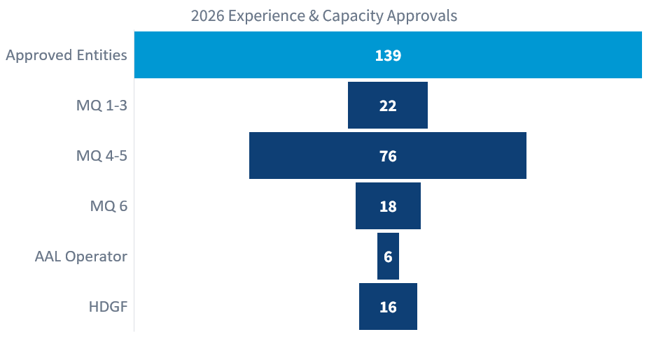
2026 Experience & Capacity
2026 Experience and Capacity window thru September 25, 2026

Slide 5
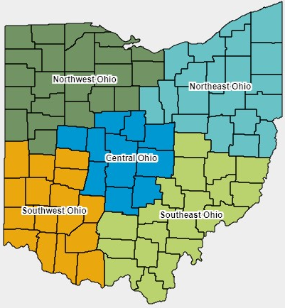
2026 9% LIHTC proposal Applications
Region | Proposals
Southeast | 6
Northwest | 11
Central | 14
Southwest | 9
Northeast | 22
Total | 62

Slide 6
2026 9% LIHTC Calendar
Date | Programmatic Benchmark
December 2, 2025 thru January 8, 2026 | Submission window for 2026 9% LIHTC Experience and Capacity and CHDO Certifications
Thursday, February 26, 2026, by 5:00 p.m. EST | Deadline to submit Proposal Applications
Friday, April 10, 2026 | OHFA release of Preliminary Competitive Scoring and Minimum Financial and Threshold Review
Thursday, April 16, 2026, by 5:00 p.m. EDT | Deadline to respond to OHFA’s Preliminary Competitive Score and Minimum Financial and Threshold Review
May 2026 OHFA Board Meeting | Results of 2026 9% LIHTC reservations presented for OHFA Board approval
Thursday, September 17, 2026, by 5:00 p.m. EST | Deadline to submit Final Applications

Slide 7

9% LIHTC –
Experiencing a Gap?
Contact your OHFA analyst and/or Section Chief
OHFA working on a Toolbox of options

Slide 8
2026 4% LIHTC only & AAL
Open-cycle application window opens
  February 2 – October 30, 2026
4 - Projects Submitted
  3 - New Construction
  1 – Rehabilitation
  Total = 675 units
Notes:
2024 4% only – 51 Final apps submitted, 44 moved to final review

Slide 9
SFY 2027 Ohio LIHTC
Date | Programmatic Benchmark
Until Friday, May 1, 2026, at 5:00 p.m. Eastern Time (ET) | Window to submit Frequently Asked Questions (FAQ)* starting with OHFA Board Approval of Guidelines
Monday, June 8, 2026, by 5:00 p.m. ET | Proposal Applications due
Wednesday, July 15, 2026 | OHFA releases Preliminary Competitive Scoring
Wednesday, July 22, 2026, by 5:00 p.m. ET | Applicant response deadline for OHFA's Preliminary Competitive Scoring
August 2026 OHFA Board Meeting | OHFA announces invitations to submit Final Applications
Tuesday, December 15, 2026, by 5:00 p.m. ET | Applicant deadline to submit Final Applications
Two weeks from notification letter | Applicant deadline to respond to deficiencies in OHFA’s Final Application review
June 2027 OHFA Board Meeting | All Ohio LIHTC must have OHFA Board approval

Slide 10

Bond Gap Financing (BGF)
Allocation from ODOD – May/June
Expect First Draft Summer 2026…
Cross-Cutting Regulations
  Environmental Review
  Section 3
  Davis Bacon Prevailing Wage
  Build America, Buy America (BABA) Act
Notes:
$14.35 million for PY 2025 = 4 projects

Slide 11
Housing Development Gap Financing (HDGF)
Date | Programmatic Benchmark
December 2, 2025, through January 8, 2026 | Submission window for Experience and Capacity and Reviews
Friday, December 19, 2025, by 5:00 p.m. | Deadline to submit Frequently Asked Questions* (FAQ)
Thursday, February 5, 2026, by 5:00 p.m. | Deadline to submit Proposal Applications
Friday, February 27, 2026 | OHFA release of Preliminary Competitive Scoring and Minimum Financial and Threshold Review
Friday, March 12, 2026, by 5:00 p.m. | Deadline to respond to OHFA’s Preliminary Competitive Score and Minimum Financial and Threshold Review
April 2026 OHFA Board Meeting | OHFA announces invitations to submit Final Applications
Thursday, July 30, 2026, by 5:00 p.m. | Deadline to submit Final Applications
Two weeks from notification letter | Applicant deadline to respond to deficiencies in OHFA’s Final Application Review

Slide 12

2027 DAS PREVIEW
Focusing on Policy and Partnership

Slide 13
WHAT WE HEARD
Where cost containment is incentivized, guidelines are a necessity.
If the playing field isn’t set at a reasonable level, bad players will edge out good players in a race to the bottom.
Developers that want to provide good housing will lose awards to the biggest cost-cutters.

Slide 14

BUT let’s create guidelines that are bumpers and
not barriers…

Slide 15
BUT let’s create guidelines that are bumpers and
not barriers…
Good players shouldn’t struggle to comply
with the rules, because they’re already throwing
strikes. The rules are there to keep bad players in line…
…and keep OHFA from dealing with any gutter balls!

Slide 16
Top Priority = Reduce Construction Costs so we can fund More Units of Affordable Housing

Slide 17
What is our baseline expectation?
All projects funded by OHFA should meet the Ohio Building Code and the Ohio Energy Code.

Slide 18

What is our mission?
What do we value that is above and beyond code baseline?
Affordability
Durability
Quality of Life
Accessibility
Proposed “Pillars”

Slide 19
What is our mission?
What do we value that is above and beyond code baseline?
These pillars are our guiding principles. Every rule in the DAS should serve one of these principles.
Affordability
Durability
Quality of Life
Accessibility
Proposed “Pillars”

Slide 20

VALUE of the investment:
ALSO CONSIDER
Cost
How much does it further the mission versus how much does it cost?
Mission
Cost Benefit Analysis

Slide 21

Pillar: Affordability
WHY IS IT IMPORTANT?
Providing affordable housing is what it’s all about.
Affordability extends beyond rent: utility costs and property damages affect both resident and owner.

Slide 22
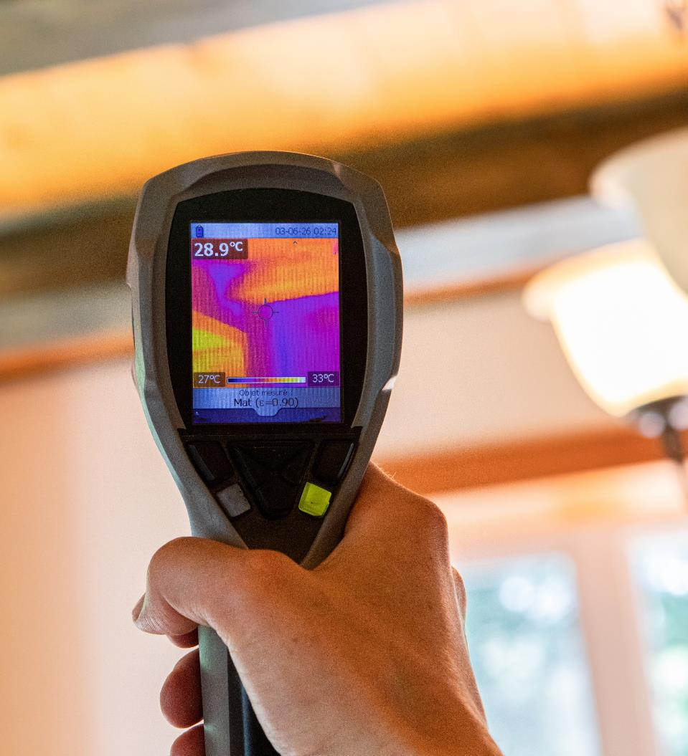
Pillar: Affordability
EXAMPLES FROM THE DAS:
Blower door testing or
thermal imaging
Efficient HVAC equipment
Low-flow plumbing fixtures

Slide 23

Pillar: Durability
WHY IS IT IMPORTANT?
Funding restrictions and low capital reserves place constraints on future repairs.

Slide 24

Pillar: Durability
EXAMPLES FROM THE DAS:
Semi-solid core doors
KCMA performance standard for cabinets
Generally replacing items with less than 50% expected useful life remaining

Slide 25

Pillar: Quality of Life
WHY IS IT IMPORTANT?
Our housing should be decent, safe, and dignified.

Slide 26
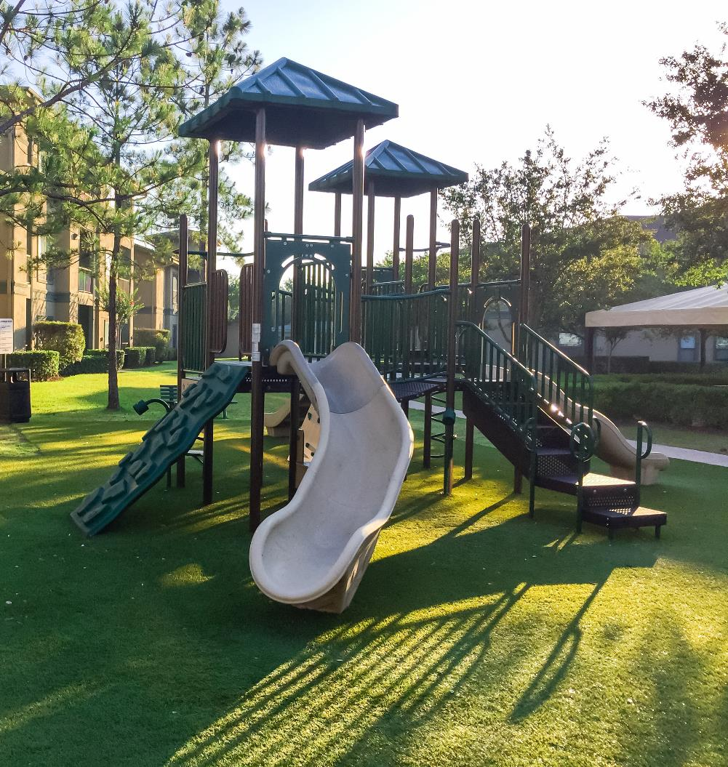
Pillar: Quality of Life
EXAMPLES FROM THE DAS:
Minimum 0.042”
vinyl siding
Building and
site amenities
Radon testing

Slide 27

Pillar: Accessibility
WHY IS IT IMPORTANT?
The free market consistently under-produces accessible housing.
On top of that, Ohio has a rapidly aging population – ranking 6th highest in the nation for residents age 60 and above!

Slide 28

Pillar: Accessibility
EXAMPLES FROM THE DAS:
Extra “Section 504 Mobility Units”
Cooktop aligned with counter height
32” clear doorways

Slide 29
Pillar: Accessibility
Building Code
2% Type A units
All others Type B
Fair Housing
All units Type B
Section 504
5% Type A units
2024 DAS
5% Type A units
5% semi-ambulatory
We can better define this so developers will take advantage of the flexibility!

Slide 30

So… HOW DO WE build this?
2027
DAS

Slide 31
So… HOW DO WE build this?
1) Simple, clear rules and no “OHFA-isms”
2) Individual requirements for Rehab and New Construction
3) Create a path for Sustainability Compliance without full certification
4) Gather design requirements in the body of the document, not appendices
5) Allow developers the flexibility to select from options that increase accessibility
6) Add commentary throughout to explain the why (create transparency and dialogue)
7) Create a separate format where developers can share their own suggestions and tips

Slide 32
Design & Architectural Standards (DAS)
March 2026
Stakeholder Input
April 2026
OHFA Analysis & Drafting
May 2026
First Draft & Public Comment Period
September 2026
Final Draft OHFA Board Approval
January 1, 2027
Effective

Slide 33
Working with OHFA
Jennifer Cahill, Architecture & Construction Section Chief
jcahill@ohiohome.org
(614) 387-1646
www.ohiohome.org
You can also send feedback to: DAS@ohiohome.org

