Slide 1

The Missing Middle:
A Philanthropic Response
OHC Fall Symposium
September 10, 2025

Slide 2
The Missing Middle” Discussion….
Involves a variety of diverse needs:
Workforce housing
Housing for young professionals
Housing for working families
General housing affordability for households 80%-120% of AMI
Both new product and preservation of existing.

Slide 3
Naturally Occurring Affordable Housing…
Is an important part of this discussion.
What happens to older apartment complexes with modest rents over time?
  Limp along with smaller increases that may or may not address maintenance and cap/ex needs
  Deteriorate until a City orders it to be vacated
  Significant renovation by current or new owner accompanied by huge rent increase
This housing stock is large, diverse with the good, the bad and the ugly
Over last decade rents have increased substantially due to extended period of new supply not keeping up with population growth
Columbus has had several high-profile cases of displacement due to physical condition or rent increases, repositioning

Slide 4
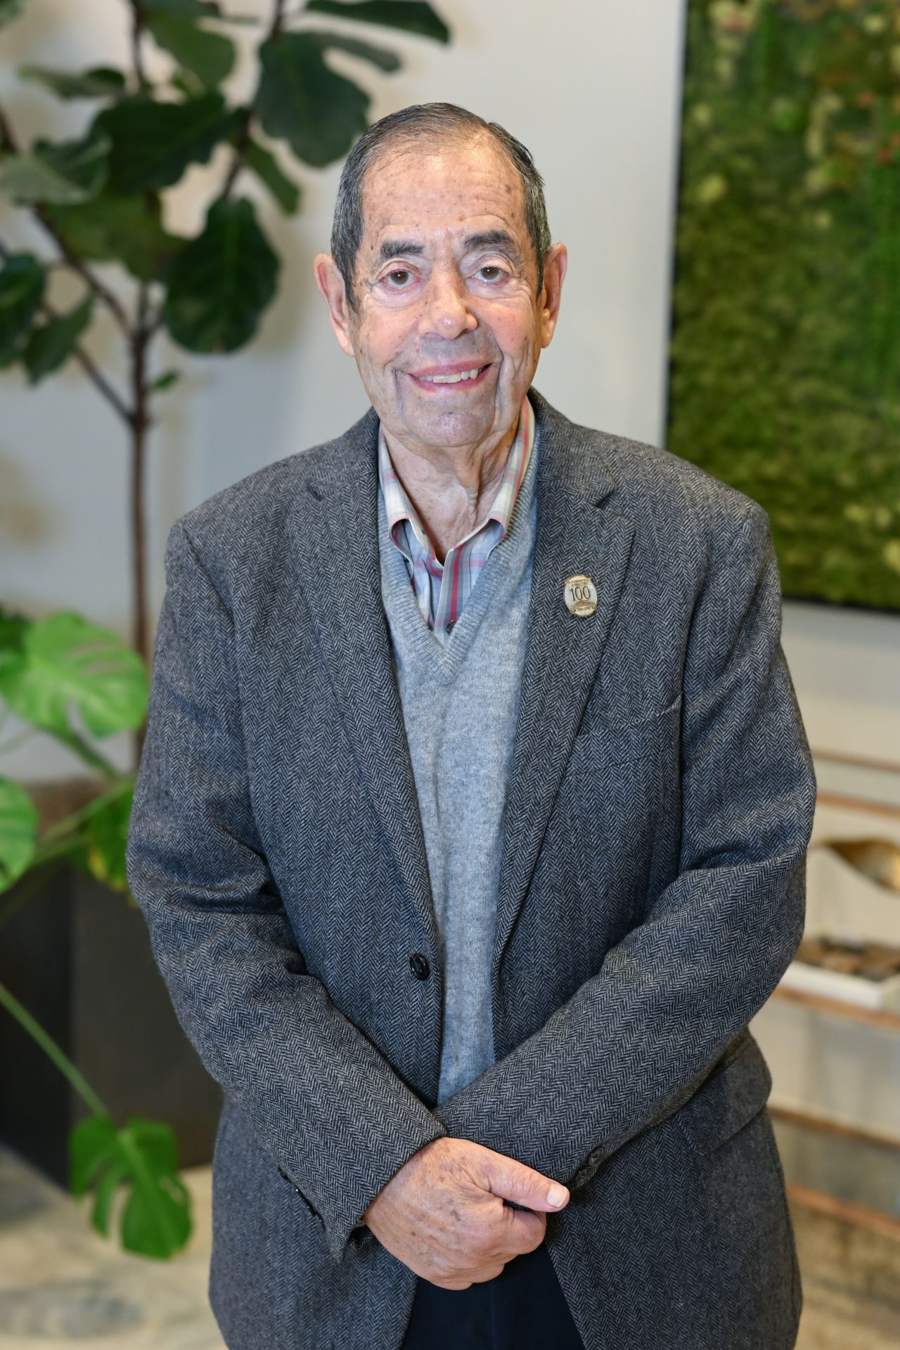
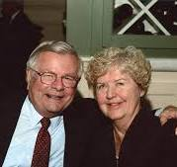
Columbus Housing Enterprise is…
The vision of two successful Columbus real estate developers and their families.
The Patriarchs
  Robert Weiler: The Robert Weiler Company
  Don Kelley – The Kelley Companies

Slide 5
The Weiler and Kelley Families
Have partnered together for over 40 years
Developed over 10,000 units of market rate housing and commercial properties
Own Oakwood Management Companies, one of Columbus’s largest property management companies
The families have a long history of philanthropy and community leadership and have been honored over the years for their impact on the community

Slide 6
The Weiler and Kelley Families
The Vision
Create a new nonprofit led by a range of community leaders and organizations
Sell older but well-maintained properties to the nonprofit at 50% of their appraised value
Have the nonprofit own the properties to preserve the modest rents as “naturally occurring affordable housing’ communites
Both patriarchs have supported Rev. John Edgar’s efforts to revitalize the Southside of Columbus and worked with him to organize CHE

Slide 7
CHE Leadership
President
Rev. John Edgar - Retired Methodist Minister / Executive Director of Community Development For All People CDC
Board
Chair: Hal Keller - Retired CEO of Ohio Capital Corporation for Housing
Vice Chair: Patty McClimon - Senior Vice President, Chief Strategy Officer: Nationwide Children’s Hospital
Treasurer: Leah Evans – CEO of Homeport
Secretary: Jordan Henderson - Director of Multifamily & Special Projects Nationwide Children’s Hospital
Bob Bitzenhofer – Vice President of Planning and Development, CMHA
Britanny Eddy – Housing Director, Community Development For All People
John Wymer – Retired CEO of Oakwood Management
Jim Weiler - Chief Sustainability Officer, The Robert Weiler Company and Weiler Family Representative
Peggy Kelley – Kelley Family Representative

Slide 8
Columbus Housing Enterprise
The Properties: 640 Units
Property | Number of Units | City | School District
Copperleaf | 108 | Columbus | Dublin
Cabot Cove | 288 | Columbus | Hilliard
Rosebrook | 244 | Columbus | Gahanna

Slide 9
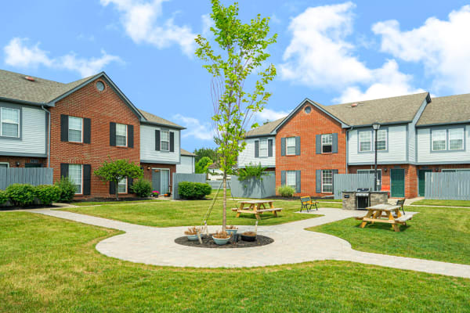
Copperleaf: 108 Units – Dublin Schools

Slide 10
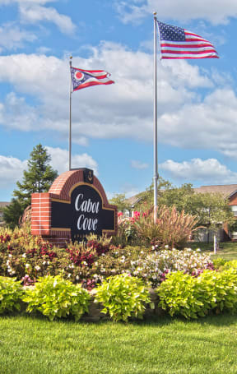
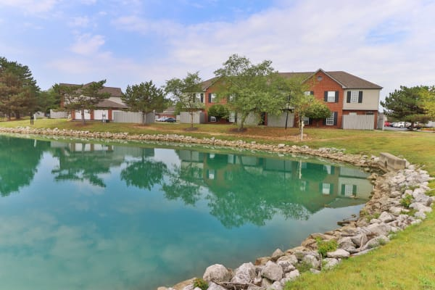
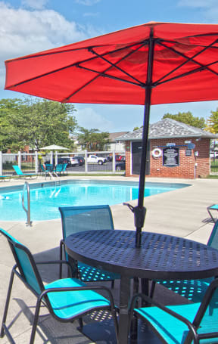
Cabot Cove: 288 Units - Hilliard Schools

Slide 11
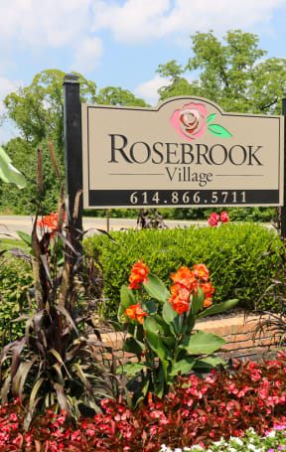
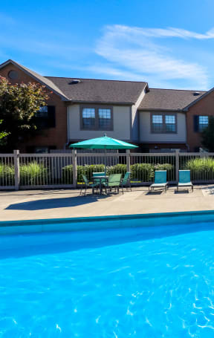
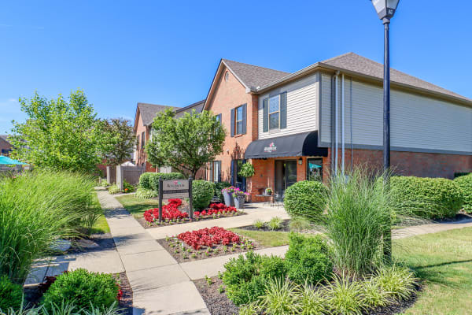
Rosebrook: 244 Units - Gahanna Schools

Slide 12
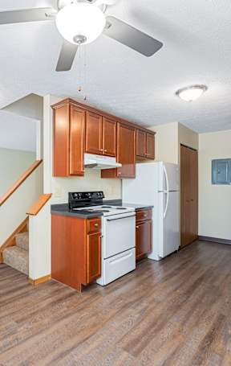
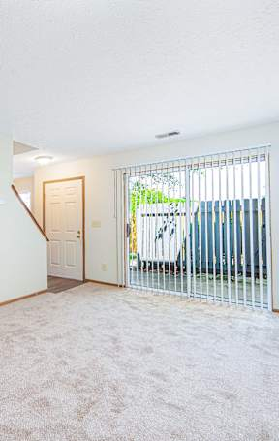
The Units
All units are two-bedroom one bath townhomes
Size: 850 sf-900 sf
Strong occupancy
Rents vary by tenure and levels of unit upgrades but are in the $1,000-$1,300 range
Well maintained with extensive landscaping
Upgrades completed upon turnover
Annual cap/ex plans implemented
Each property has physical challenges to be addressed:
  Polybutelene plumbing breaks
  Older windows
  Aging HVAC units

Slide 13
Columbus Housing Enterprise
The Financial Model
The Weiler and Kelley families sell a property to CMHA at $75 K per unit: properties have been appraised at around $150 K per unit
  CMHA applies for real estate property tax exemption in the year following the closing: CMHA ownership enables property to be exempt
  At closing CMHA executes a long-term lease with CHE
CHE, through a lender, has used Freddie Mac affordable housing loan products to finance the acquisition
  10-year loan, 30–35-year amortization, rates range from 5.73%-5.77%
Due to the low acquisition price and loan to value ratio, CHE has been able to receive excess loan proceeds to finance cap/ex, resident services, CHE reserves and operations. Cash flow distributions are used for these as well
Owners use bargain sale/charitable contribution deductions and other tax strategies to address capital gains issues

Slide 14
Columbus Housing Enterprise
Timeline
2022:
  CHE established and receives as a 501 ( c ) 3 approval from IRS
  CMHA/CHE purchases Copperleaf in Dublin School District using a loan from Ohio Capital Finance Corporation and a seller note (Thank You OCFC!)
2023:
  CMHA/CHE purchases Cabot Cove in Hilliard School District
  CMHA/CHE refinances OCFC and seller note using a Freddie Mac perm loan product
2025
  CMHA/CHE purchases Rosebrook Village in Gahanna District
  Total Financing: $59 M

Slide 15
Columbus Housing Enterprise
The People
Income:
  Based on income verifications at initial leasing, 75% or more at 80% AMI or below
Household characteristics: Copperleaf Example
  30% Female Head of Household
  64% Households with Children
  Ethnicity:
    52% Minority
    Each property is diverse, but populations vary by location (African American, Latino, Indian, Middle Eastern, African, etc.)
Tenure:30 % turnover per year

Slide 16
Columbus Housing Enterprise
Income Targeting, Rents and Compliance
Legal Restrictions
  CMHA Lease provisions, required to obtain tax exemption, are 30% of Households at or below 80% of Median
  Goal of 10% Housing Choice Vouchers
Self Restrictions
  CHE has self restricted 100% of new residents at 80% or below
  Can change if impacts occupancy / marketability
  No tenants above 80% asked to move
Rents: At $1,000 - $1,350 per month, rents are at or a little but above LIHTC 60% rents for two-bedroom units
Compliance monitoring: Income verification at initial occupancy only: NO annual income recertification

Slide 17
Supportive Services
Service Providers (Copperleaf and Cabot Cove):
  CMHA RISE Center (in property budget)
  Hilliard Food Pantry Plus (CHE pays out of distributions of net income from properties)
Services by Hilliard Food Pantry Plus include:
  Fresh Produce Van
  Newsletter and Community Events
  Summer Camp Scholarships
  Summer lunch program on-site
  Emergency Assistance – Columbus Foundation Acts of Kindness
Property Improvement Examples:
  Picnic are and Gazebo
  Doggie Park
Challenge: Finding the right mix of services without conveying message that these properties are “Low Income Housing”. Many residents do not consider themselves “Low Income”.

Slide 18
Our Team
Oakwood Management retained as property manager
Staff:
  President: Rev. John Edgar part time
  Asset Manager: Lori Tillis part-time
  Board Members contribute time and talent in specific areas
Development Advisor: CMHA – Bob Bitzenhofer and others
Financial Management: Homeport – Val Schwarzmann, Plante-Moran
Legal: Adam Saad, Saad and Saad
Lender: Lument – Joey Hague
Construction Advisor: OCCH – Kip Lewis, Jim Dreiss, CMHA
Resident Services Providers: RISE Center and Hilliard Food Pantry Plus

Slide 19
Columbus Housing Enterprise
Summary
CHE is a big tent nonprofit committed to preservation of “Naturally Occurring Affordable Housing” and the preservation of affordable housing at risk
CHE is a lean but well capitalized and financially self-supporting organization
Accomplishments to date have been successful but all due to the generosity of the Weiler and Kelley Families
The Future: explore other opportunities to further our mission

Slide 20
NOAH Intervention Strategies
Summary
Renter-focused strategies
Strategies for existing owners
Financing interventions for the purchase of properties

Slide 21
NOAH Intervention Strategies
Renter-focused strategies
  Rent assistance
Strategies for existing owners
    Often focused on smaller owner/properties
    Tax abatement
    Energy efficiency programs
    Lower interest loans for improvements
    Technical assistance
    Example: Chicago Community Investment Corporation

Slide 22
NOAH Intervention Strategies
Financing interventions
  Focused on larger properties
  Objective: transfer to new owner with long-term affordability restrictions
  Vehicles
    Loan products
      Access to capital with flexible terms to acquire properties to preserve affordability
      Terms vary from quick-strike fund to longer term loans
      Some structured as a type of mezzanine financing
      Examples: Enterprise and NEF/LISC loan products

Slide 23
NOAH Intervention Strategies
Acquisition Funds
  Nonprofit intermediary combines patient private capital with longer term financing to acquire properties
  Return to investors generally cash on cash return from net income
  Some layer in gap financing from local government
  Targeting varies by market and missiom
    50% of households at 80% of median as an example
    Not all deeply targeted
  Examples:
    Texas (formerly Austin) Housing Conservancy
    Washington Housing Conservancy
    Greater Minnesota Housing Fund
    Turner Multifamily Impact Fund
    In early discussion: Ohio Housing Innovation Fund

