Slide 1


2025- The Summer Of Housing

Slide 2
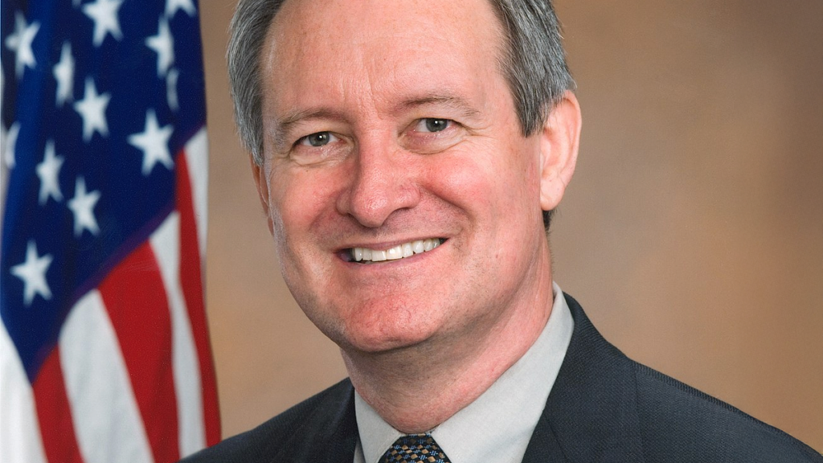
OB3 Senate Finance Chairman Mike Crapo

Slide 3

Congressman Mike Flood

Slide 4
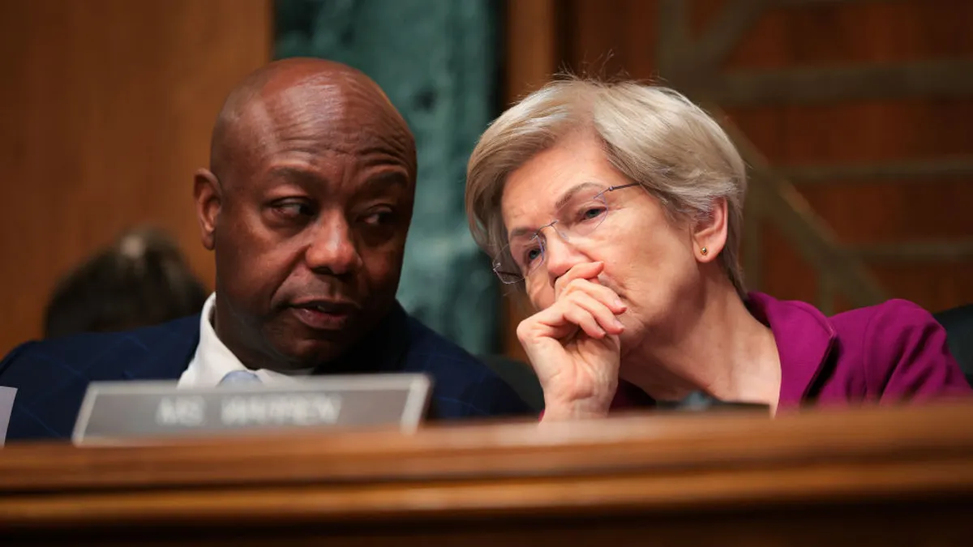

Senate Banking “The ROAD to Housing”

Slide 5

THUD House and Senate Budgets
House version healthy Rental Assistance- no HOME
Senate version healthy Rental Assistance – HOME restored

Slide 6


Government Shutdown or Continuing Resolution?

Slide 7

Regulatory Reform for Housing?

