Slide 1


The Missing Middle
Ohio Housing Symposium
Fall 2025
614.221.1114 T | www.ﬁnancefund.org

Slide 2
Who We Are
  Mission-guided, non-profit organization that drives capital, real estate development services, and other resources to low- and moderate-income communities to improve quality of life
  Approximately $155MM in assets
  Launched our Real Estate Development in 2018
  Launched General Contractor entity in 2021
614.221.1114 T | www.ﬁnancefund.org

Slide 3
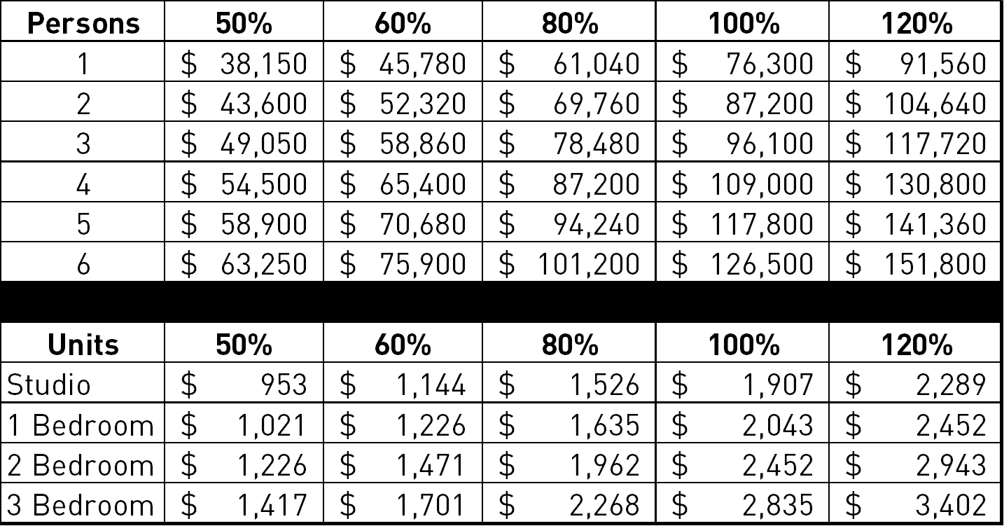
Income and Rent Limits
(Franklin County)
614.221.1114 T | www.ﬁnancefund.org

Slide 4

New Construction
For Sale Townhomes
First For-Sale Land Trust Townhome Condos
Developed in Ohio
Built in Franklinton on
City-owned land
High Demand
614.221.1114 T | www.ﬁnancefund.org

Slide 5
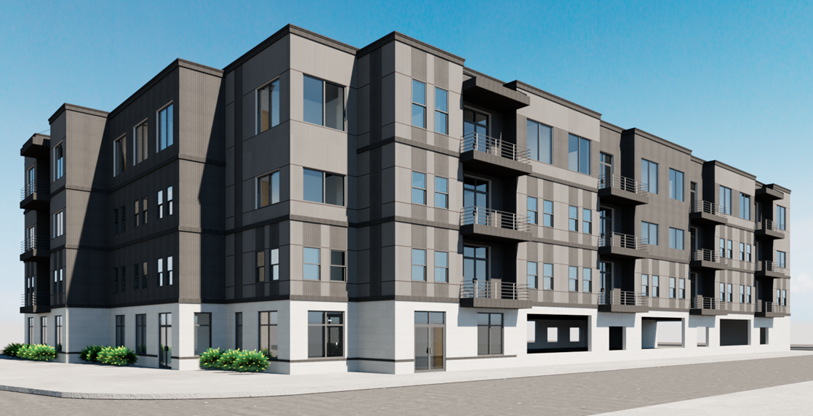
New Construction
For Sale Condo Flats
Building off the townhome
Model
Next project will
be condo flats built
in conjunction with the
City’s “Zone-In” initiative
614.221.1114 T | www.ﬁnancefund.org

Slide 6
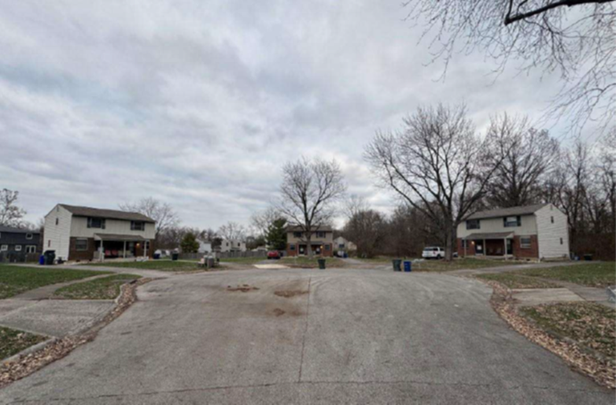
Naturally Occurring Affordable Housing
On the rental side,
Finance Fund engages in
preservation, new construction,
adaptive reuse projects
Finance Fund can take a lead
or passive investment role
614.221.1114 T | www.ﬁnancefund.org

Slide 7
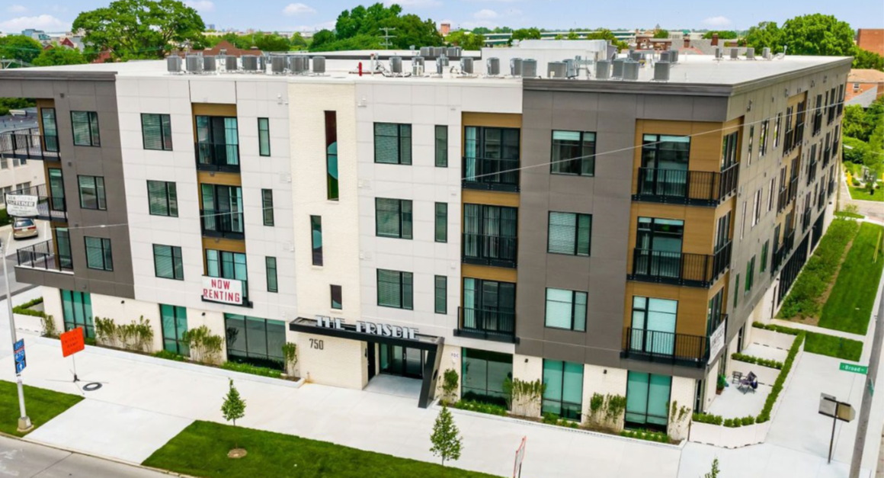
New Rental Construction
The Frisbie
New construction on the
edge of the urban core
Built with higher end
Finishes, amenities, and
Unit sizes
Rents target below 100% AMI
614.221.1114 T | www.ﬁnancefund.org

Slide 8
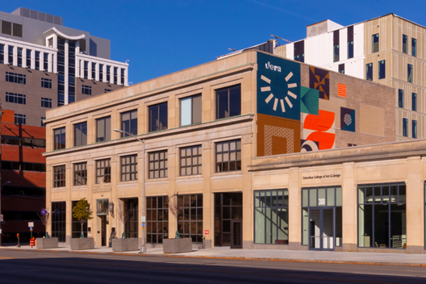
New Rental Construction
Vera on Broad
Mixed-use project with adaptive
reuse of a historic office building
and the addition of a parking
garage and multi-family housing
Rents average below 80% AMI
614.221.1114 T | www.ﬁnancefund.org

