Slide 2
September 2025
OHC Fall Symposium

Slide 3
Office of Multifamily Housing
Program Updates
Cross Cutting Guidelines
Future Goals
9% QAP

Slide 4

Welcome 4% Housing Tax Credit Section Chief!
Benjamin Peyton

Slide 5
LIHTC Program updates
9% LIHTC
4% LIHTC with Bond Gap Financing (BGF)
4% LIHTC with Ohio LIHTC
4% LIHTC
4% LIHTC
Limited soft resources from HOME, NHTF, and OHTF
4% LIHTC
Annual round
Limited Ohio LIHTC (OLIHTC)
New construction and adaptive reuse only
Annual round
Rehabilitation only
4% LIHTC Affordable Assisted Living (AAL)
4% LIHTC
Limited 9% LIHTC
Limited soft resource for (HOME) CHDO
New Construction, Adaptive Reuse, and Rehabilitation
Annual round
4% LIHTC (only)
New Construction, Adaptive Reuse, and Rehabilitation
Open-round
New Construction only
Open-round

Slide 6
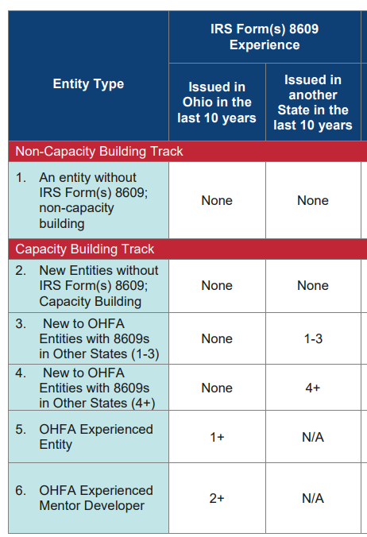
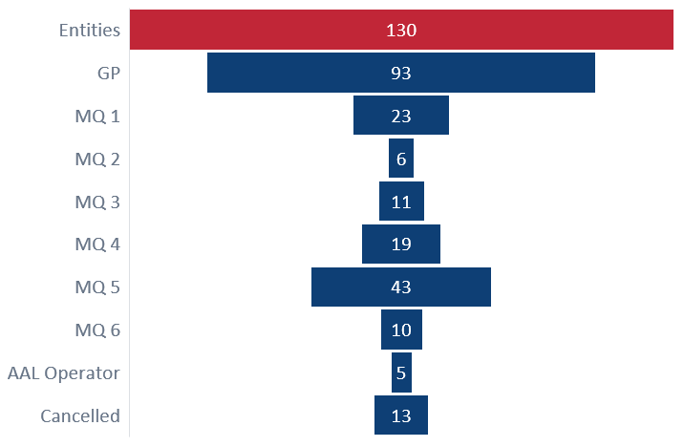
2025 4% Experience & Capacity
Friday, September 26 is the final day to submit E/C for 2025 4% LIHTC applications.

Slide 7
2026 Experience and Capacity Standards
Draft 1 posted
Updated to include HDGF (non-LIHTC) Experience and Capacity
A Minimum Requirements section for HDGF Program
Clarified General Partner/Member review
Added Definitions
Experience and Capacity Review Cycle Added (Annual or 2-year)
Made a 2-year review for experienced developers (MQ #4-6)
Allow for those approved in 2025 to use their 2025 approval for 2-years. (This would assist 72 entities so far!)
Removed Lien & Litigation due at E/C.
This is consistent with current FAQ.
Accepting Public Comments until Tuesday, October 1, 2025.
Capacity of Developer, Experience, Successful Completion
Due with application as they include county-specific L&L.

Slide 8
4% LIHTC only
Friday, October 30, 2025, is the final day to submit a 2025 4% LIHTC applications.
Monday, February 2, 2026, opens the 2026 4% LIHTC open-cycle application window.
Notes:
2024 4% only – 51 Final apps submitted, 44 moved to final review

Slide 9
4% LIHTC Program Guidelines
4% LIHTC QAP
No update for 2026
2026 BGF
Pending Federal Budget for HOME & NHTF
SFY 2027
Ohio LIHTC
Application window opens February 2, 2026
Planning Dec/Jan
Final Draft Mar/Apr
Planning Dec/Jan
Final Draft Mar/Apr
Goal: OHFA Board Project approval by May 2027.
Keep aligned or off-set due dates?

Slide 10
SFY 2026 Ohio LIHTC & 2025 BGF Calendar
Benchmark | 2025 Calendar
Proposal Applications Due | August 14, 2025, by 5:00 p.m. ET
Preliminary Scoring and Experience and Capacity Reviews | September 19, 2025
Applicant Response to Preliminary Deadline | September 25, 2025, 5:00 p.m. ET
Invitations to submit Final Application | October 2025 Board Meeting
Final Applications Due | January 29, 2026, by 5:00 ET
Applicant deadline to respond to deficiencies in OHFA’s Final Application Review | Two weeks from notification letter

Slide 11
SFY 2026 Ohio LIHTC
51 Applications
Metropolitan – 33 Applications
Rural – 18 Applications
Application Requests
Ohio LIHTC: ~$480 million
OHTF: $70.4 million
Construct 6168 units
Oversubscribed
5:1

Slide 12
2025 BGF Calendar
16 Applications
PJ – 8 Applications
Non-PJ – 8 Applications
Request HOME, NHTF & OHTF:
~$42.3 million
Preserve 2021 units
Oversubscribed
4:1
Notes:
$14.35 million for PY 2025 = 4 projects

Slide 13
Cross Cutting Guidelines
Experience and Capacity Standards
Multifamily Rental Underwriting Guidelines
Design and Architectural Standards (DAS)
Multifamily Bond Guidelines

Slide 14
Cross Cutting Guidelines
2026 Experience & Capacity Standards
Multifamily Rental Underwriting Standards
Draft 1 September 2025
Effective for PY 2026 Programs:
September or October 2025
Effective January 2026
DAS
Kick-off at Ohio Housing Conference 2025
Effective January 2027
Multifamily Bond Guidelines
25% Bond Test
October 2025
Effective January 2026
HDGF
9% LIHTC
4% LIHTC (all)

Slide 15
Future Goals
9% LIHTC
4% LIHTC
HOME
NHTF
OHTF
Ohio LIHTC

Slide 16
Future Goals
Production
Geographic Distribution
Cost Reasonableness

Slide 17
2025 9% LIHTC Calendar
Benchmark | 2025 Calendar
Proposal Applications Due | February 27, 2025
Preliminary Scoring and Minimum Threshold and Financial Reviews (via FTS) | April 11, 2025
Applicant Response to Preliminary | April 17, 2025, by 5:00pm EDT
2025 9% LIHTC Reservations Presented to Board | May 2025 Board Meeting
2025 9% LIHTC Final Applications Due | September 18, 2025, by 5:00 EDT

Slide 18
2026-2027 9% LIHTC QAP Timeline
Stakeholder Engagement – January thru early May
First draft
July 2025
30-day comment period
Final draft September 2025
Proposal Applications due February 2026
Final Applications due September 2026
Second draft
Aug/Sept 2025
10-day comment period
Public Hearing 7/30
Notes:
All recordings posted on our website
1st draft was posted July 1st, and received comments through August 1,
Talk about comments posted to our website
We are planning to post the second draft tomorrow, and will enter into a 10 day comment period to allow us to bring a final draft for approval at the September board meeting
This will then allow for proposal applications to be due in February 2026 and a final application due in September 2026 for those that receive a LIHTC reservation

Slide 19
Ohio 9% LIHTC Ceiling, 2021-2026
IRS 202X Calendar Year Population Figure, Ohio
X
IRS 202X Per Capita Multiplier
=
Ohio’s 202X 9% LIHTC Ceiling
Program Year | 2021 | 2022 | 2023 | 2024 | 2025 | 2026 (Est.)
IRS Ohio Population Estimate | 11,693,217 | 11,780,017 | 11,756,058 | 11,785,935 | 11,883,304 | 11,981,477
IRS Per Capita Multiplier | $2.8125 | $2.6000 | $2.7500 | $2.9000 | $3.0000 | $3.4000*
Annual 9% LIHTC Ceiling | $32,887,172 | $30,628,044 | $32,329,159 | $34,179,211 | $35,649,912 | $40,737,022
9% LIHTC Reservations | 39 | 31 | 31 | 24 | 23 | TBD
*President Trump’s Big Beautiful Bill expands the 9% LIHTC program, increasing 9% LIHTC allocations by 12%
Notes:
Before diving into the comments and the changes that will be made, I want to highlight how our LIHTC ceiling is calculated and how we plan to allocate these funds to build and or preserve affordable housing for low-income Ohioans
Start off by highlighting how The Ohio 9% LIHTC Ceiling is calculated
Our 9% Credit ceiling is calculated by taking Ohio’s population and then multiplying it by the IRS per capita multiplier.
After multiplying these two together, it gives us the total amount of 9% LIHTC that OHFA receives to allocate to projects for that calendar year.
In the table below:
You can see Ohio’s 9% LIHTC Ceiling for years 2021 to 2025, with estimated numbers for program year 2026.
As you can see, Ohio’s population has continued to slightly increase from 2021 to 2025.
As for the per captia multiplier, we’ve seen some shifts in this amount, but it’s important to note that the IRS per capita multiplier increased 10 cents in 2024 to $3 per person for 2025, bringing our 2025 Credit ceiling to $35.6M in annual 9% LIHTC credits, which we were able to fund 23 deals.
Lastly, I just wanted to point out that President Trump’s Big Beautiful Bill, which was signed on July 4th, expands the 9% LIHTC program, increasing 9% LIHTC allocations by 12%. Thus, I am estimating that our 9% credit ceiling for 2026 will be roughly $40.7M in annual 9% credits. However, it is important to keep in mind, that we have been seeing equity pricing decrease and it is predicted to continually decrease, so it may not necessarily mean we are able to fund many more deals.

Slide 20
Funding Pools
New Affordability – General Occupancy
  39% of 9% LIHTC Ceiling
New Affordability – Senior
  26% of 9% LIHTC Ceiling
Preserved Affordability
  13% of 9% LIHTC Ceiling
Populations with Special Housing Needs
  22% of 9% LIHTC Ceiling

Slide 21
Three Primary scoring categories
Policy Goal: Prioritizing LIHTC projects in high-opportunity areas while addressing housing need and ensuring efficient use of tax credits
  Neighborhood Opportunity Index* (General & Senior) (40%)
  Housing Needs Index* (35%)
  Annual LIHTC Request per LIHTC unit** (25%)
Example: Project is in census tract with Neighborhood Opportunity Score of 80, Housing Needs of 50, and project maximizes its score for credits per unit
  Opp (80*0.4) + HNI (50*0.35) + CPU (25) = 74.5 out of 100
*Updated annually or every two years based on contract;
**Updated annually based on Multifamily Residential Construction Index
Notes:
Clarified scoring calculations
Neighborhood Opportunity Index
Maximum points: 40
Rationale: The Neighborhood Opportunity Index is created in partnership with the Urban Institute and will be updated on an annual basis to ensure the latest available data is used. Two Neighborhood Opportunity Indices have been created to identify opportunity based on the project’s targeted population: General Occupancy and Senior.
The Neighborhood Opportunity – General Occupancy Index distills four critical categories of neighborhood opportunity with 20 total indicators into one Neighborhood Opportunity – General Occupancy Index Score number that aims to identify access to economic and social opportunity by individual Census Tracts. These categories include opportunity-rich and inclusive neighborhoods, high-quality education, rewarding work, and healthy environment and access to good healthcare.
The Neighborhood Opportunity – Senior Index distills three critical categories of neighborhood opportunity with 15 total indicators into one Neighborhood Opportunity – Senior Index Score number that aims to identify access to economic and social opportunity by individual Census Tracts. These categories include opportunity-rich and inclusive neighborhoods, rewarding work, and healthy environment and access to good healthcare.
Projects that serve seniors, must use the Neighborhood Opportunity - Senior Index. All other projects must use the Neighborhood Opportunity - General Occupancy Index.
The project’s raw Neighborhood Opportunity Index Score is delineated in OHFA’s 2026-2027 Neighborhood Opportunity Index and will be worth 40% of the project’s total score.
Neighborhood Opportunity Index: The AHFA will automatically calculate the Neighborhood Opportunity Index score based on the project’s location (majority of LIHTC units) within a 2020 Census Tract and the population served.
Calculation: Census Tract raw Neighborhood Opportunity Index score × 0.40
Housing Needs Index
Maximum points: 35
Rationale: The Housing Needs Index is created in partnership with the Urban Institute and will be updated on an annual basis to ensure the latest available data is used. The Housing Needs Index distills three critical categories of Housing Need with four indicators total into one Housing Need Index Score, which aims to identify census tracts with the greatest housing need across Ohio. These categories include housing supply, affordable housing stock, and affordability.
The census tract’s raw Housing Needs Index Score is delineated in OHFA’s 2026-2027 Housing Needs Index and will be worth 35% of the project’s total score.
Housing Needs Index: The AHFA will automatically calculate the Housing Needs Index score based on the project’s location (majority of LIHTC units) within a 2020 Census Tract.
Calculation: Census Tract raw Housing Needs Index Score × 0.35
Annual LIHTC Request per LIHTC Unit
Maximum points: 25
Rationale: To incentivize cost efficiency and maximize the impact of limited 9% LIHTC resources, OHFA will award up to 25 points based on the annual LIHTC amount requested per LIHTC unit. Projects that request $27,500 or less in annual LIHTC per LIHTC unit will receive the full 25 points. For requests above $27,500, points are reduced proportionally, with no points awarded for requests of $47,500 or more. Please note that these minimum and maximum amounts will be adjusted to the Multifamily Residential Construction Index and updated with the Final draft submitted for OHFA Board Approval, estimated September 2025
Annual LIHTC Request per LIHTC Unit: The AHFA will automatically calculate this criterion by dividing the project’s total annual 9% LIHTC request by the total number of LIHTC units in the project and then applying the formula below.
Calculation: =MAX(0, MIN(25, ((47500 - [Annual LIHTC Request per LIHTC Unit]) / 20000) * 25))

Slide 22
Award Sequence
CHDO-Sponsor Set Aside (two highest scoring eligible projects; max one per region; max one per funding pool)
Tenant Populations with Special Housing Needs Set Asides
  PSH Policy Framework (two highest scoring eligible projects; mas one per region)
  Non-PSH Policy Framework (the highest scoring eligible project)
  Balance of State (the highest scoring eligible project)
Preserved Affordability Subpools (max one per region)
  Preserved Affordability – Rental Assistance (highest scoring eligible project)
  Preserved Affordability – LIHTC Resyndication (highest scoring eligible project)

Slide 23
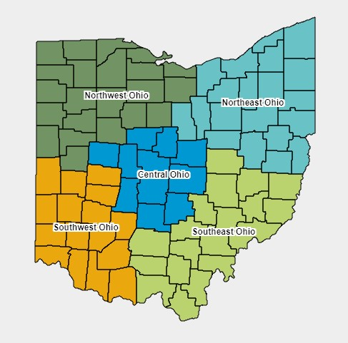
Regional distribution of Credit ceiling by population
Region | Population | Percent of State
Central | 2,262,608 | 19%
Northeast | 4,311,826 | 37%
Northwest | 1,482,013 | 13%
Southeast | 783,786 | 7%
Southwest | 2,939,813 | 25%
Grand Total | 11,780,046 | 1

Slide 24
Award sequence Continued
Regional Award Sequence
  Highest Scoring Rural project (New Affordability – General Occupancy or Senior)
  Highest Scoring project from the opposite funding pool
    (e.g., If Step 1 funds a General Occupancy project, Step 2 will fund the highest-scoring Senior project).
Statewide Redistribution of Unused Regional Credits
  QCT with Concerted Community Revitalization Plan (two projects)
  Community Impact Strategic Initiative (at least one project)
Forward Allocation Adjustment

Slide 25
 | Set Aside | Funding Pool | Region | Metropolitan or Rural
Project 1 | CHDO Sponsor |  | N/A | N/A
Project 2 | CHDO Sponsor |  | N/A | N/A
Project 3 | PSH #1 | TPSHN | N/A | N/A
Project 4 | PSH #2 | TPSHN | N/A | N/A
Project 5 | Non-PSH | TPSHN | N/A | N/A
Project 6 | Balance of State | TPSHN | N/A | N/A
Project 7 | Rental Assistance | PA | N/A | N/A
Project 8 | LIHTC Resyndication | PA | N/A | N/A
Project 10 | N/A | NA-GO | Southeast | Rural
Project 11-12 | N/A | New Affordability | Northwest | Rural and ?
Project 13-15 | N/A | New Affordability | Central | Rural and ??
Project 16-18 | N/A | New Affordability | Southwest | Rural and ??
Project 19-22 | N/A | New Affordability | Northeast | Rural and ???
Project 23 | Strategic Initiative
* At least two projects (Project 1 – 22) must be in a QCT with Concerted Community Revitalization Plan

