Slide 1
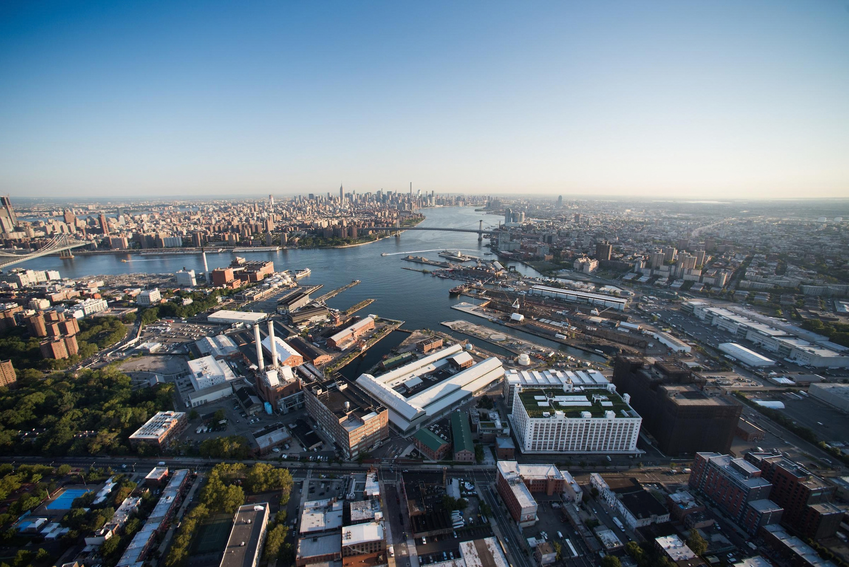

Sustainability

Slide 2

Who We Are
w
•LISC is one of the country’s largest
community development nonprofits, helping forge vibrant, resilient communities across America.
•We work with residents and partners to close
gaps in health, wealth, and opportunity so that people and places can thrive.

Slide 3




How LISC Works
w
•We do this through:
•Our network of
•36 local markets and nationwide rural program
•Our four fund-management
•
10 program areas that
and tax credit •syndication affiliates
address all the building blocks
of community wellbeing

Slide 4
Building Economic Resilience for a Sustainable Future
Communities across the country are grappling with rising energy and housing costs, aging infrastructure, and the growing frequency of weather-related disasters. LISC Sustainability helps communities meet these challenges head-on by offering strategies that integrate sustainability into the core of local community and economic development.
We work holistically across all aspects of LISC’s work—housing, small business, workforce, education, and health—to expand access to affordable energy, resilient infrastructure, and new economic opportunities. Through catalytic capital, hands-on technical assistance, and strategic partnerships, we help communities build a healthier, more affordable, and resilient future.
$430M
A COMMUNITY’S HOMES,
BUSINESSES, AND INFASTRUCTURE MUST BE BUILT TO BE DURABLE, OPERATE EFFICIENTLY, AND REMAIN AFFORDABLE OVER TIME.

Slide 5
LISC Sustainability Key Areas of Work
Sustainable Finance
Resiliency
•Build leadership in sustainability finance across the
•Strengthen local and national disaster resilience in low-
community development sector to support long-term affordability, resilience, and job creation.
income communities by mobilizing funding and financing that delivers physical and financial risk reductions through multi-sector collaboration, rooted in communities.
•Respond to growing market demand for cleaner,
healthier, and more affordable housing.
•Expand financing strategies to address increasing frequency and intensity of extreme weather events, including national bridge financing fund for recovery dollars and resiliency building features.
•Focus on high need markets – including tribal and
rural
•Support financing of construction of high-performance
•Develop initiatives that develop needed models around
buildings (prioritizing multi-family affordable) and renewable energy.
improved risk sharing, including work with the insurance sector.
•Explore opportunities in related sectors such as
•Scale pilots with state-based insurance programs for
distributed grid and sustainable community facilities.
community development assets; and water infrastructure needs.

Slide 6
Our Approach to Sustainable Finance
w
We are drawing on decades of investing experience to build a national platform for sustainable community finance—unlocking access to capital for healthier communities, affordable energy, and long-term affordability.
■LOAN PRODUCTS: LISC offers construction and bridge financing for high-performance buildings (new
construction and retrofit) and solar projects to meet evolving community needs.
■MARKET BUILDING: Partnering with local LISC offices across the nation to invest in and scale innovative
financing approaches.
■IMPACT TRACKING: Leveraging a sustainable finance taxonomy and impact framework to track
outcomes and measure the benefits of community investments.
■PARTNER ENGAGEMENT: Collaborating with mission-aligned partners to leverage public and private
incentives and drive adoption at the local level.

Slide 7
Outcomes
Healthier and More Efficient Buildings
Produce and preserve housing units that provide enhanced tenant comfort, energy savings, and health outcomes.
Resilient Buildings
Affordable Renewable Energy
Finance solar for affordable housing that decreases energy burden for residents and provides revenue source for affordable housing developers.
Connectivity to a Changing Grid
Prepare vulnerable communities against increasing extreme-weather focused on reducing economic impacts.
Create an equitable energy future, as low-income communities are key connection points for the transformation of energy infrastructure.
35

Slide 8
Sustainable Finance Products
w
Product
Renewable Energy
(Solar)
Use Case
Finance installation of solar systems and bridge timing of tax credits/incentives
Typical Structure
Construction-to-perm or bridge loan
Incentive Bridge Loan
Bridge committed grants, tax credits, or local incentive programs
-Short-term, interest-only bridge loan
High Performance Buildings
New construction (≥20% improvement over IECC) or rehab rehabilitation (≥15% improvement over baseline) with verified improved energy performance improvements
Working capital to contractors and developers delivering renewable energy projects
-Construction + permanent financing
Small Business Loans
Short-term working capital loans tied to project pipeline

Slide 9
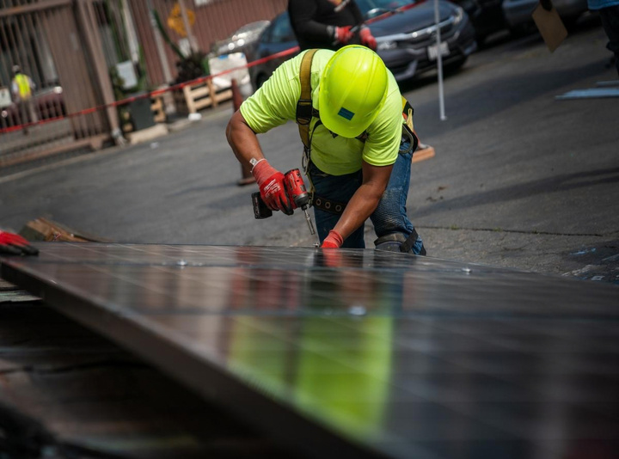
LISC IN ACTION: DELIVERING LOCAL IMPACT AT SCALE
Deploying Sustainable Finance products to meet community needs across the country.
Park Synagogue Redevelopment – Cleveland Heights, OH
• • •
•
~$7.75M LISC financing supporting $50M historic re-development
Conversion to mixed-use: housing + arts & education space
Incorporates geothermal + high-performance upgrades that reduce operating costs
Advances long-term sustainability and community revitalization
Unity Solar Group – Illinois
• • •
$1.5M LISC working capital financing to solar installer
Supports projects under Illinois Solar for All program
Enables scaling of LMI residential & commercial solar deployment

Slide 10
LISC IN ACTION: DELIVERING LOCAL IMPACT AT SCALE
w
Deploying clean energy to strengthen housing affordability and community stability in the DC area.
$5.4MM Solar Investment
• •
Financing the installation of solar systems across multiple affordable housing properties and a legacy church
Structured to support long-term energy savings and operating efficiency with $1.1MM in projected savings over 20 years
What It Enables
630+
RESIDENTS SERVED IN 6 PROPERTIES RESULTING IN $55,000 in ANNUAL ENERGY SAVINGS
• • • •
Reduces operating costs for affordable housing providers Improves long-term financial stability of properties Advances decarbonization and distributed energy adoption
Supports residents and communities facing rising cost pressures

Slide 11


Contact
w
Kristen Baker Executive Director
LISC Greater Cincinnati & LISC Louisville
E: kbaker@lisc.org

