Slide 1
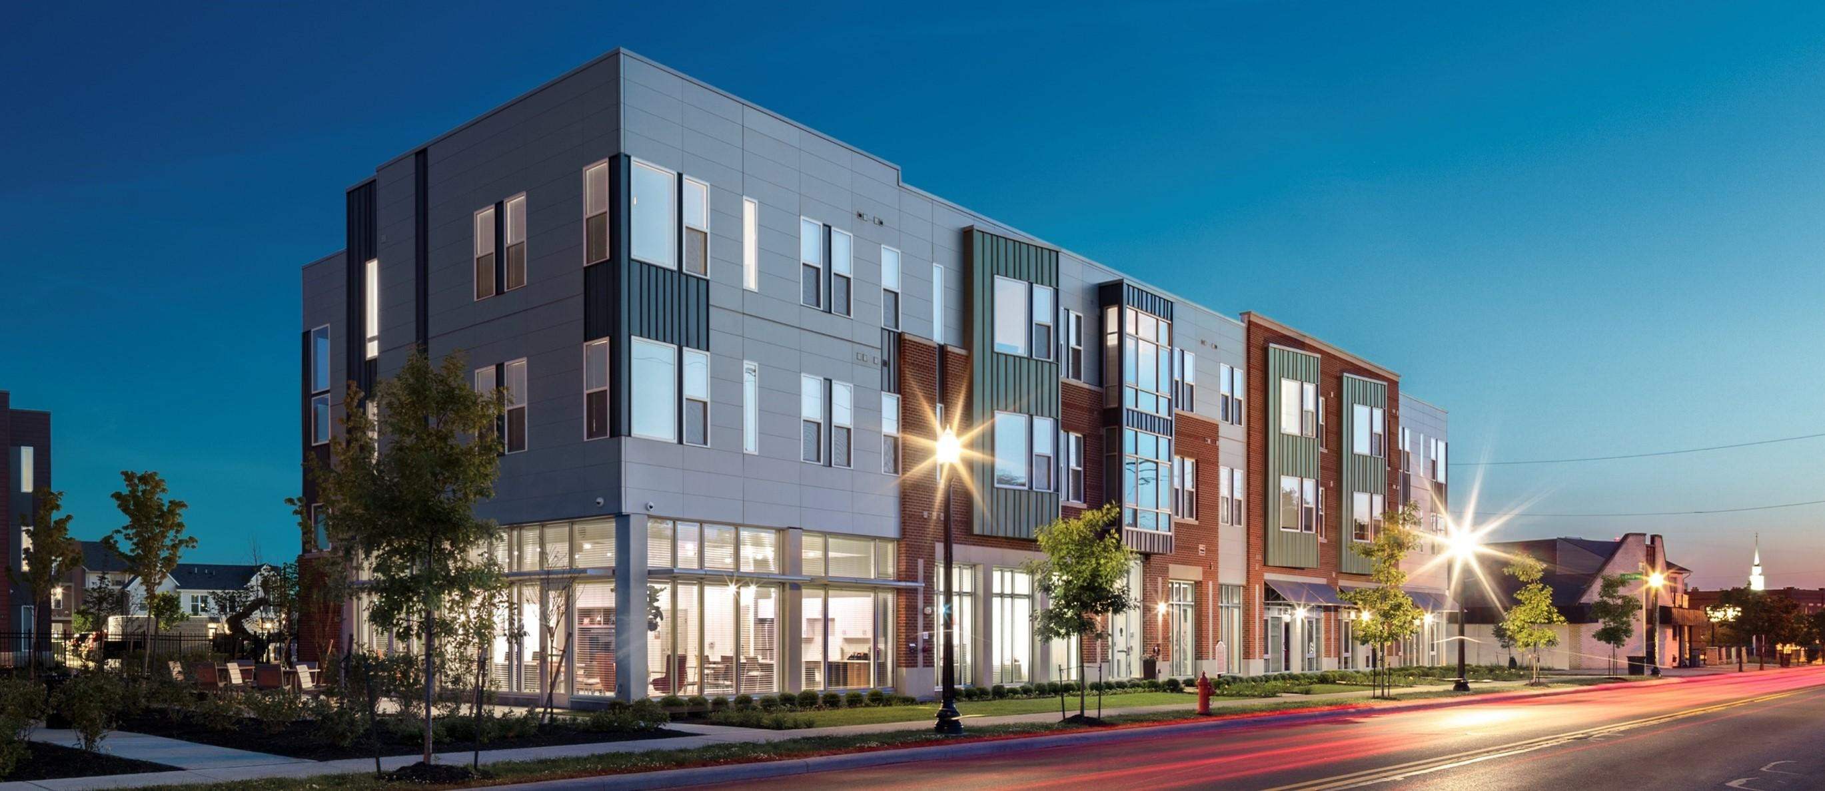


Housing Choice Voucher Program
WEDNESDAY, APRIL 22nd, 2026

Slide 2
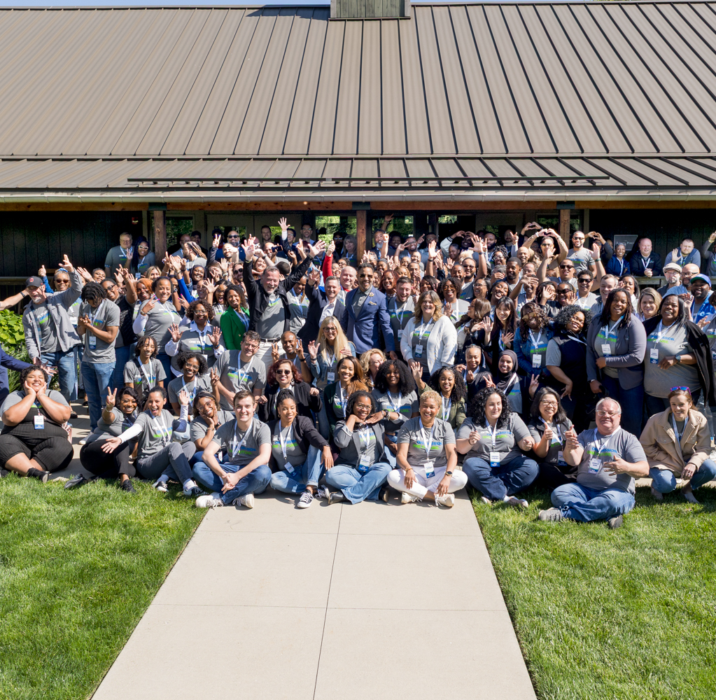
Who We Are
Mission
CMHA helps people access affordable housing through collaborative partnerships to develop, renovate, and maintain housing; promote neighborhood revitalization; and assist residents in accessing needed social services.
Vision
A national leader in opening doors to innovative housing for diverse communities, empowering residents and improving neighborhoods.
Values
Community – Commitment – Collaboration

Slide 3
Housing Choice Voucher Program
Tenant Based Vouchers
Project Based Vouchers
VASH Vouchers
FUP Vouchers
Mainstream Vouchers
Emergency Housing Vouchers

Slide 4
Voucher Allocation and Subsidy
HUD grants specific number of vouchers
HUD grants specific dollar amount of subsidy
HA’s greatest challenge is to balance the number of vouchers against the amount of subsidy

Slide 5
Unique Aspects of Project Based Vouchers
Subset of total vouchers
Ceiling of 30% of total vouchers
Ceiling of 25% of total number of units unless PSH
Awards of PBVs must be completed
Vouchers attach to units not awarded to families

Slide 6
Funding Issues (Shortfall)
Shortfall occurs when subsidy is insufficient to cover all issued vouchers
Impacted by inflation and rising payment standards
When shortfall is projected HAs must take steps to reduce subsidy expenditures
First action is to stop issuing vouchers
Directly impacts commitment to PBV projects

